Slide 1
EU request on spatial trade-off analysis between reducing the extent of mobile bottom-contacting gear (MBCG) disturbance to seabed habitats and potential costs to fisheries
Presentation of ICES Advice of 15 April 2024 to SWWAC
Presented by Simon Jennings, ACOM vice-chair
11 July 2024

Slide 2
DGENV request (summarised)
Provide analyses of the economic value of fisheries using mobile bottom contact gears (MBCG), linked spatially to their distribution.
Define the distribution of fishing value and distinguish ‘core’ and ‘peripheral’ fishing grounds per métier.
Determine the spatial variation in ‘core fishing grounds’ over time.
Provide a trade-off analysis of the potential costs to fisheries of when various proportions of each MSFD broad habitat type per MSFD subdivision are not fished with MBCG.

Slide 3
ICES advice: overview
Advice provided for EU marine waters of the Baltic Sea, Greater North Sea, Celtic Seas, and the Bay of Biscay and the Iberian Coast.
Fishing with MBCG was spatially aggregated into core areas accounting for most of the total landings weight and value, and peripheral areas accounting for a small proportion of total landings weight and value.
On average, for the years 2017‒2022, 90% of MBCG landings value came from less than 50% of the fished area.
Advice includes tables and figures showing core fishing grounds, extent of persistently unfished areas, and reductions in landings value associated with increases in unfished areas by MSFD Broad Habitat Types

Slide 4
Addressing the request

Slide 5
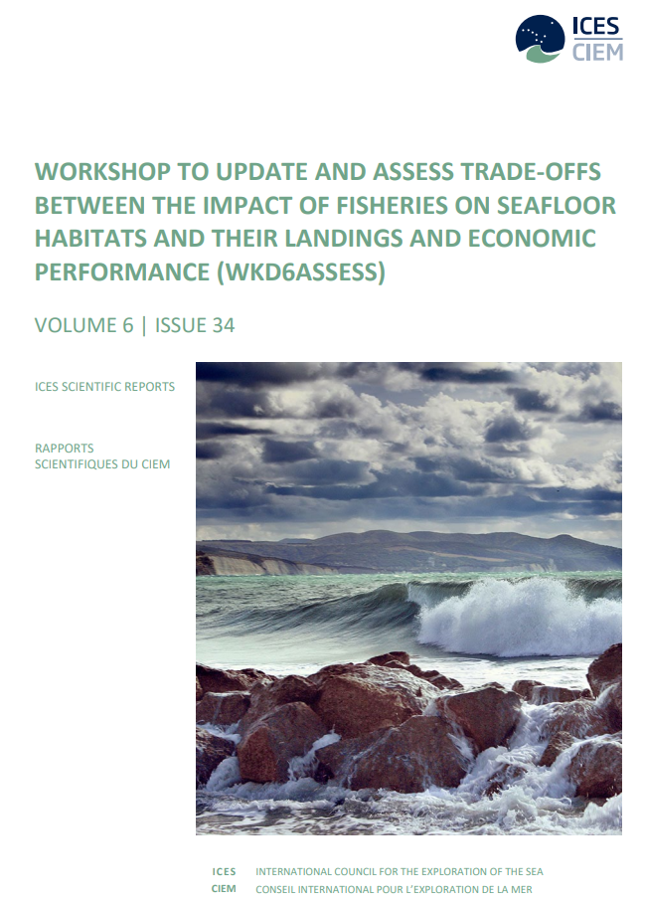
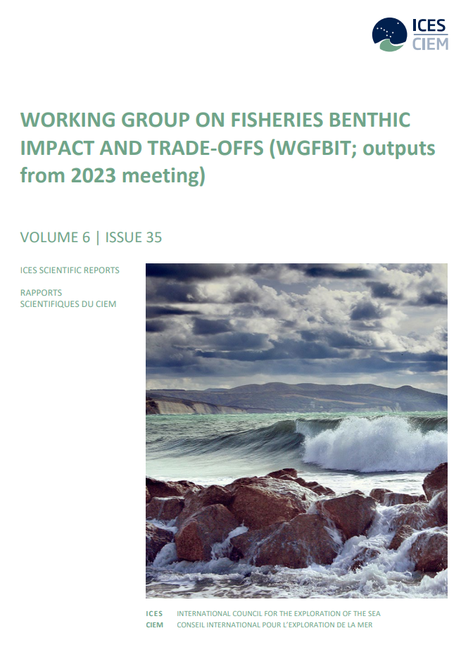
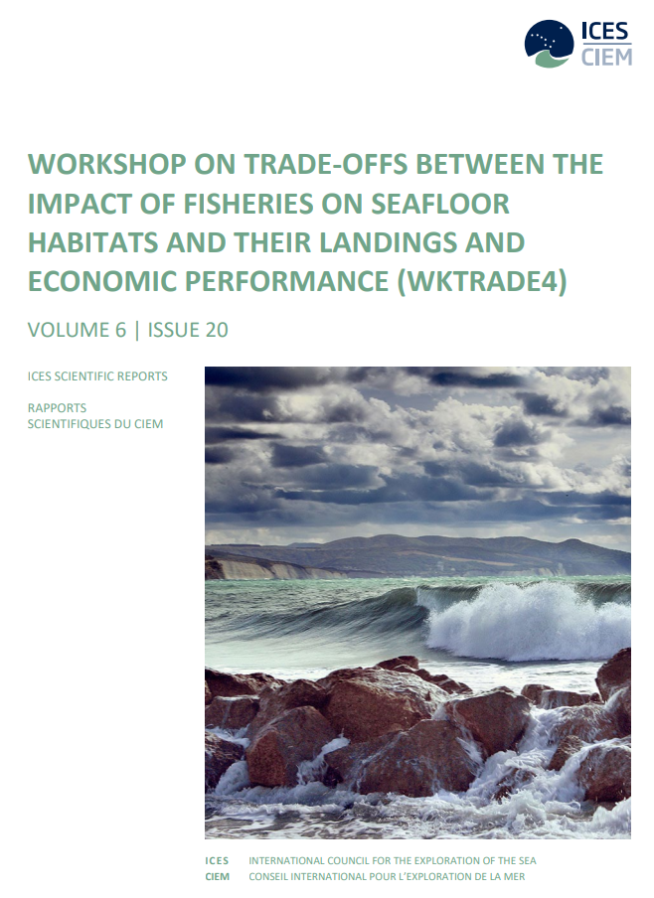
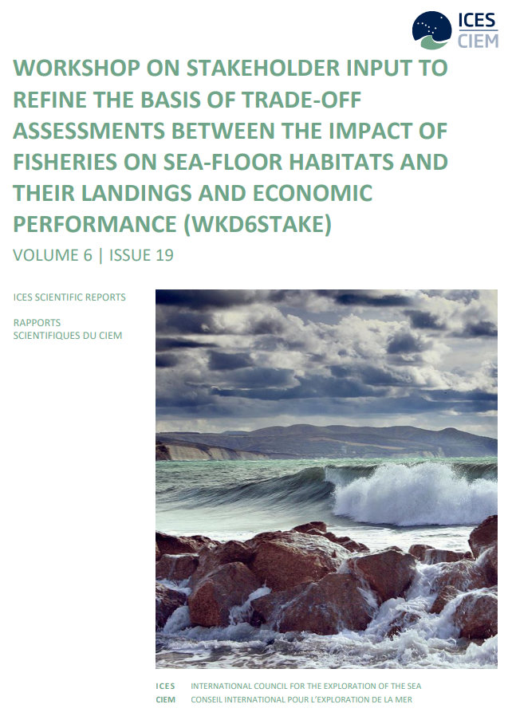
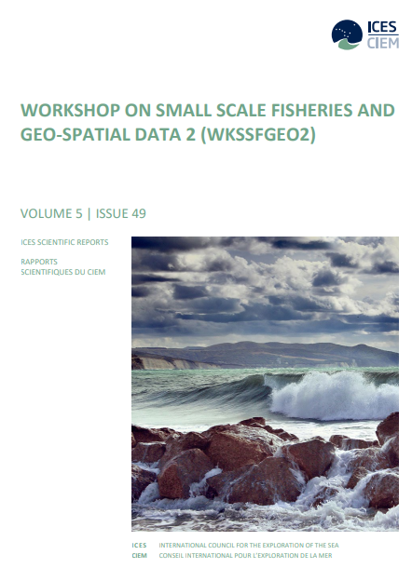
Knowledge synthesis
Sources: WKSSFGEO2: https://doi.org/10.17895/ices.pub.22789475; WKTRADE4: https://doi.org/10.17895/ices.pub.25288936; WKD6ASSESS: https://doi.org/10.17895/ices.pub.25567353; WGFBIT: https://doi.org/10.17895/ices.pub.25603191; WKSTAKE: https://doi.org/10.17895/ices.pub.25562580

Slide 6
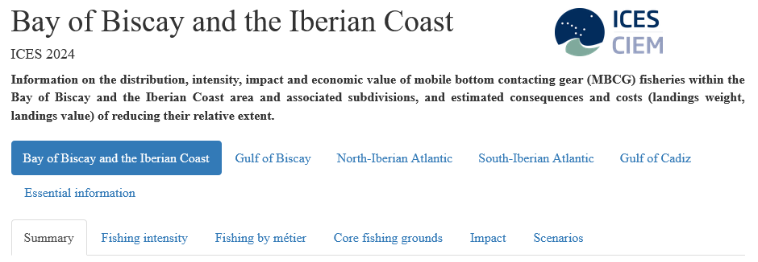
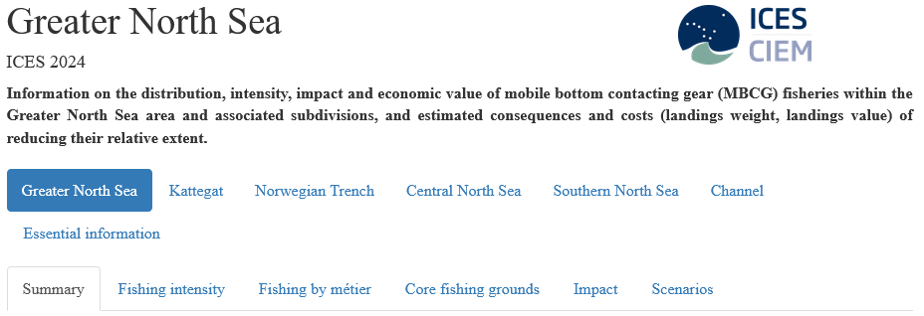
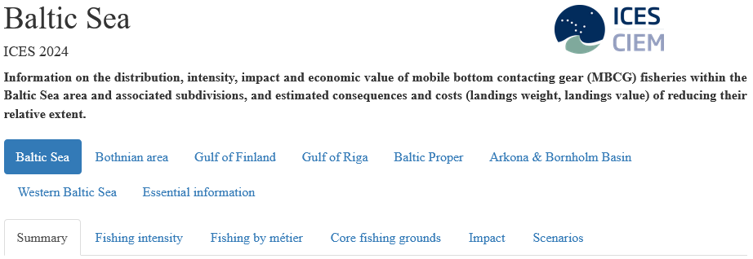
ICES advice: components
Main advice document:
Four interactive html documents:

Slide 7
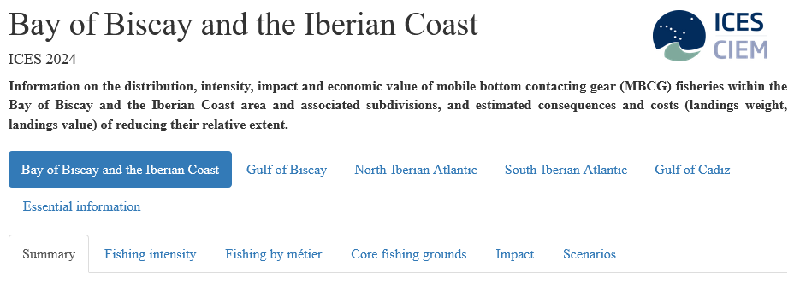
Interactive html (Bay of Biscay and the Iberian Coast)

Slide 8
ICES advice: key definitions
Mobile bottom-contacting gears (MBCG): mobile gears that contact the seabed during deployment, including bottom otter trawls, bottom seines, dredges, and beam trawls.
C-square: A grid cell of dimensions 0.05° latitude × 0.05° longitude (extent varies from 25 km² at 36°N to less than 13 km² at 66°N).
Swept-area ratio (SAR): the sum of the area swept by a defined set of MBCG in one c-square in one year, divided by the extent of the c-square.
Métier: Defined by MBCG fishing gear and target species group.
Core fishing ground: the smallest area yielding 90% of landings value, evaluated annually at the c-square scale (for a defined métier and area).

Slide 9
Elements of the advice
Fisheries yields and value
Landings weight
and value
VMS records
Logbook data
Fishing impacts
Pressure
Sensitivity
Impact
From VMS data linked to métiers and gear dimensions
From rates of recovery of seabed fauna, estimated from longevities
From the balance between depletion and recovery, from PD models

Slide 10
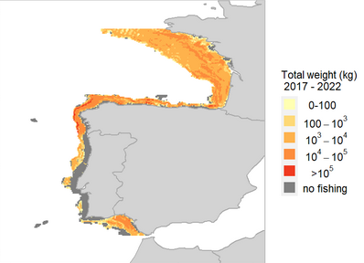
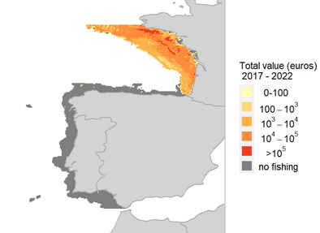
Fisheries yield and value
Grey areas are marked ‘no fishing’ information and largely indicate areas and fleets with missing data

Slide 11
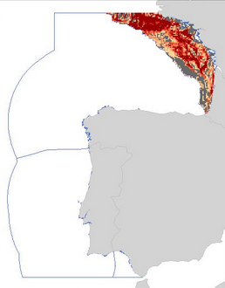
Core fishing grounds
(example OT_DMF Otter trawl demersal fish, where core >90% landings value)
Number of years as core fishing ground

Slide 12
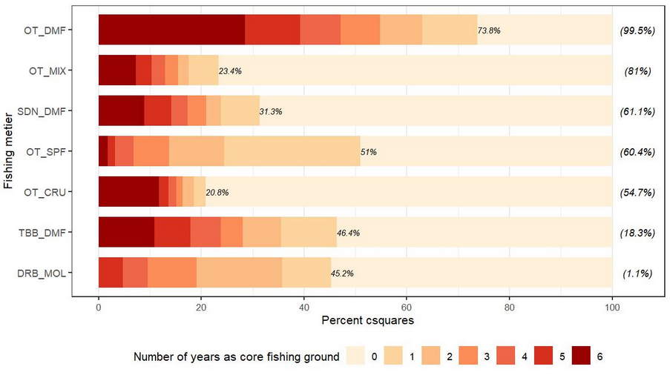
Core fishing grounds
(interannual stability, by métier)

Slide 13
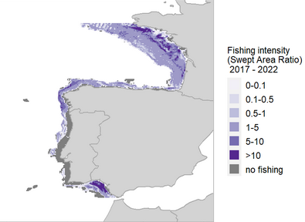
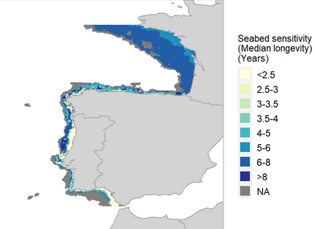
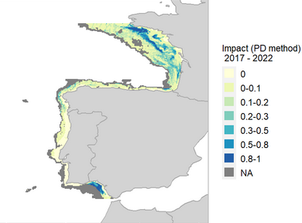
Fishing impacts (example)
Pressure
Sensitivity
Impact
From VMS data linked to métiers and gear dimensions
From rates of recovery of seabed fauna, estimated from longevities
From the balance between depletion and recovery, from PD models

Slide 14
Fishing activity: extent
 |  | Baltic Sea | Greater North Sea | Celtic Seas | Bay of Biscay and the Iberian Coast
Smallest proportion of area with 90% of fishing intensity, evaluated at c-square scale, expressed as % | 0 – 200 m | 7.8 | 46 | 41 | 46
 | 200 – 400 m | NA | 72 | 51 | 47
 | 400 – 800 m | NA | 27 | 33 | 24

Slide 15
Estimated percentage reductions in landings value when realising a minimum percentage unfished extent of all MSFD Broad Habitat types
Tradeoffs: high level example
 | Proportion of all MSFD BHT persistently unfished 2017‒2022 (%)
 | 10% | 20% | 30% | 40% | 50%
Baltic Sea | 0 | <0.1 | <0.1 | 0.2 | 0.7
Greater North Sea | 1.1 | 3.1 | 5.9 | 9.5 | 14.6
Celtic Seas | 0.4 | 3.0 | 6.6 | 11.9 | 18.6

Slide 16
Thank you
For further information:
https://doi.org/10.17895/ices.advice.25601121

