Slide 1

ICES advice
Réunion du Conseil Consultatif des eaux
Occidentales australes-CC-SUD
July 2025
Joanne Morgan
ICES ACOM vice-chair

Slide 2
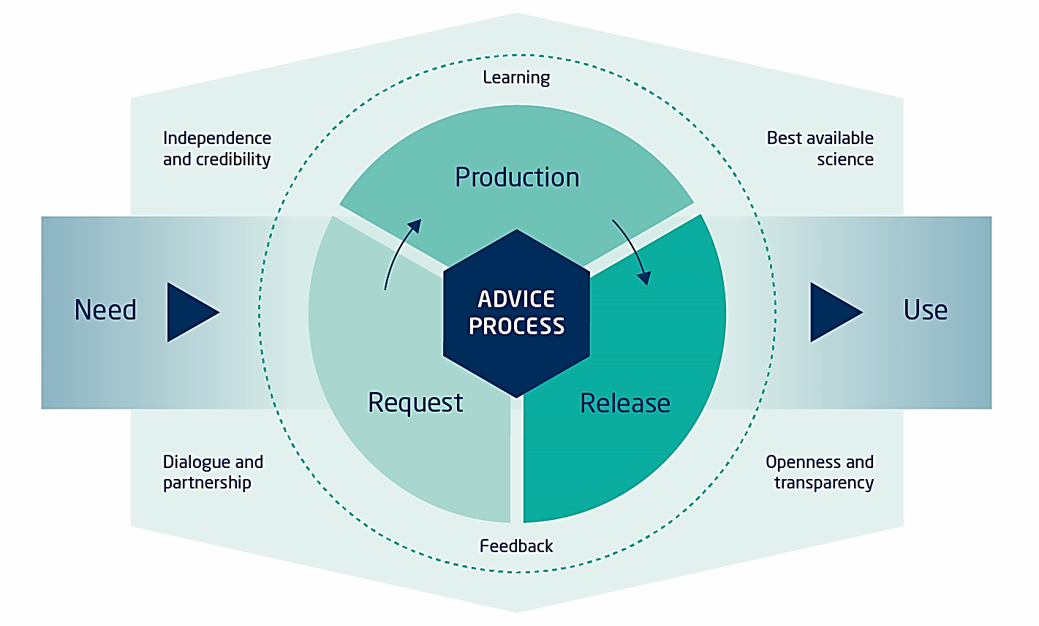
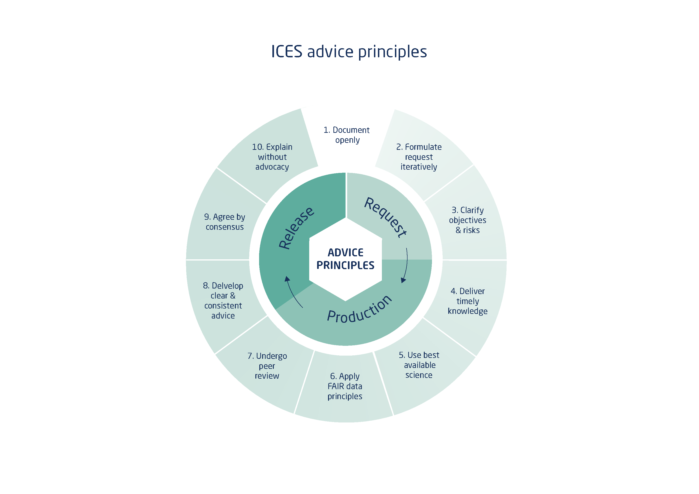
Governed by
10 principles of advice
Advice Process
No other fisheries body has these specifically stated
https://doi.org/10.17895/ices.advice.7648
Notes:
ICES has 10 principles governing the production of advice from request to release These ensure that the advice process is open and unbiased and uses the best peer reviewed science available. The advisory process is designed to work with the requester to ensure that the advice that is based on these 10 principles and is needed and useful. ICES is working with the NASCO Secretariat to develop the request for advice and advisory content to provide advice that is relevant and fit for purpose.

Slide 3
Basis of advice
Advice is based on
clients requests and is
consistent with their
policy objectives
and frameworks.
e.g. EU MAP
Must be evaluated to be
precautionary
Type of assessment
based on data available
Notes:
This has changed with the development of MSY methods for category 3 stocks

Slide 4
ICES MSY approach for category 1 & 2 stocks
For more details, see ‘ Advice on fishing opportunities 2023‘
Notes:
Do I need this?

Slide 5
Some changes this year

Slide 6
Mixed catch of stocks of the same species
Revised Guidelines
In some cases, ICES advice is for reproductively isolated populations that mix spatially for part of the year and are caught in the same fisheries during that time. Hence, these fisheries impact multiple stocks of the same species at the same time.
Advice should be consistent with ICES advisory framework
Advice should be precautionary for all stocks in the fishery; that is, advice for a stock below B_{lim} should be for zero catch where there is no F that will recover thestock to above B_{lim} with > 50% probability in the year after the year for which the advice applies

Slide 7
Mixed catch of stocks of the same species

Slide 8
Category 1
If stock < Blim [forecasts at low stock size shown to be optimistic]
  When SSB is close to or below Blim and the retrospective pattern is outside acceptable bounds ( -15%, 20%), the advice should be zero and a benchmark should be recommended.
  If retrospective pattern within acceptable bounds forecasts should be run assuming the lowest plausible productivity scenario (low recruitment, current exploitation, current growth and selectivity). If, there is no F that will bring the stock above Blim at the end of the projection year ICES will advise zero catch based on precautionary considerations

Slide 9
Category 1
Not Changing – No Transition Rules
Advice based on best available science
    All changes peer reviewed
    A transition rule that limits change suggests that ICES is not confident in the new/revised assessment
    Violates the principle of using best available science
    Comparison sometimes made with category 3 – require more caution and stability clause part of HCR
    Many possible rules – choice management decision

Slide 10
Category 1
Not Changing – No Transition Rules
ACOM agreed communication is very important
    Continue early warning
    Continue to efforts to make requesters and stakeholders more aware of benchmarks
    Improve section of advice sheet on reason for changes in advice

Slide 11
Category 3
Zero catch advice
  rules cannot technically produce zero catch advice. If the biomass index is very low, below any reasonable Blim, then zero catch advice should be given
Rfb and rb
  when zero advice has been given previously and the biomass index has shown a clear increasing trend, particularly if it has increased above Itrigger use recent catches in place of recent advice in calculation of the advice

Slide 12
Where to find the advice
https://ices-library.figshare.com/
AdviceXplorer
  https://ices-taf.shinyapps.io/online-single-stock-advice/

Slide 13
Stocks covered
Golfe de Gascogne et Eaux de la Péninsule Ibérique
Plie - plaice
Lieu jaune - pollack
Merlan -whiting
Golfe de Gascogne
Baudroies – white anglerfish
Cardines - megrims
Langoustines -nephrops
Merlu -hake
Sole -sole
Bar - sea bass
Eaux de la Péninsule Ibérique
Baudroies – black bellied and white anglerfish
Cardines - megrims
Langoustines -neprhops
Merlu - hake
Sole - sole
Anchois - anchovy
Bar –sea bass

Slide 14
Golfe de Gascogne et Eaux de la Péninsule Ibérique

Slide 15
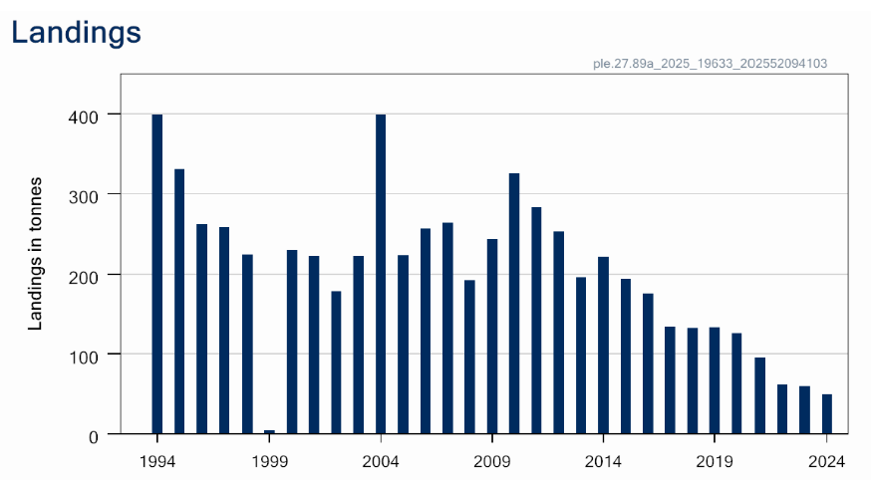
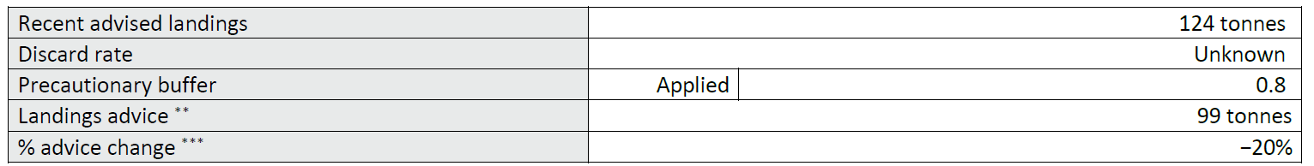
Plaice in Subarea 8 and Division 9.a (Bay of Biscay and Atlantic Iberian waters)
Advice for 2026, 2027, 2028 PA: Landings < 99 t -20%
Can not quantify corresponding catches
Category 6
Can not assess status
Discards likely >5% but uncertain – landings advice
PA buffer applied – last applied 2023
Stock definition uncertain
Landings 2024 49 t

Slide 16
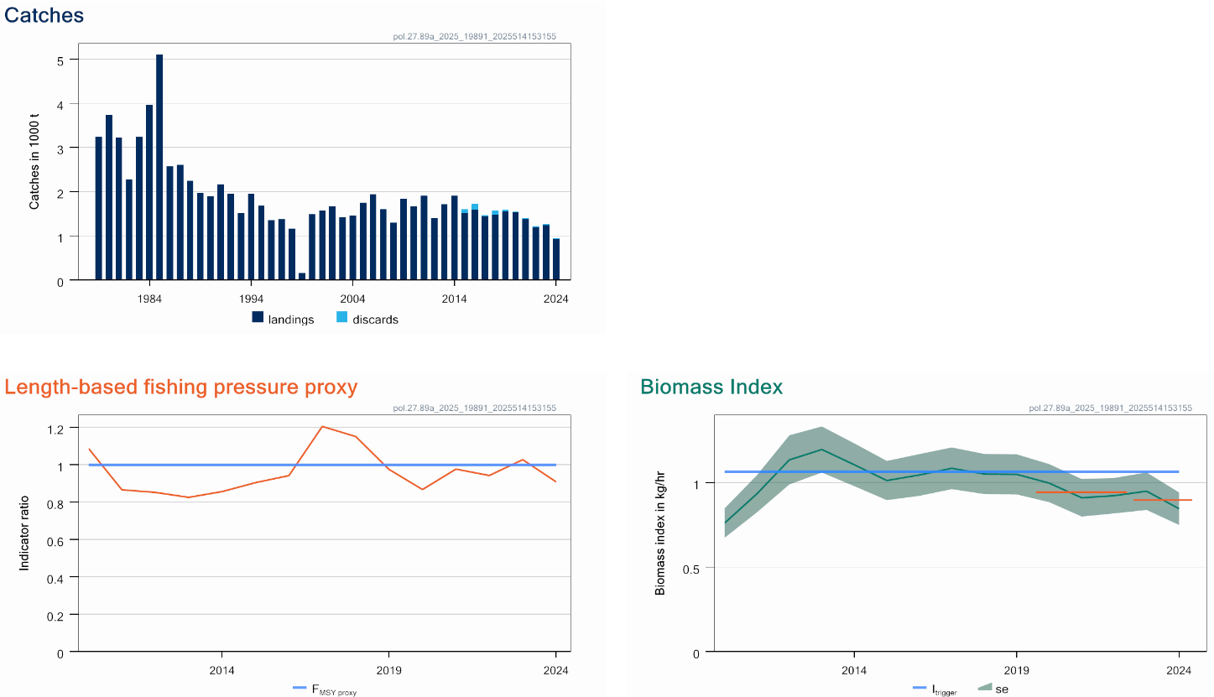
Pollack in Subarea 8 and Division 9.a (Bay of Biscay and Atlantic Iberian waters)
Advice for 2026 and 2027, MSY: commercial catch < 703 t -21%
Can not quantify total catches – lack recreational catch
F below proxy
Biomass below trigger
Decline in advice – decline in biomass –below trigger
Discards included in advice for first time
Recreational catches not quantified

Slide 17
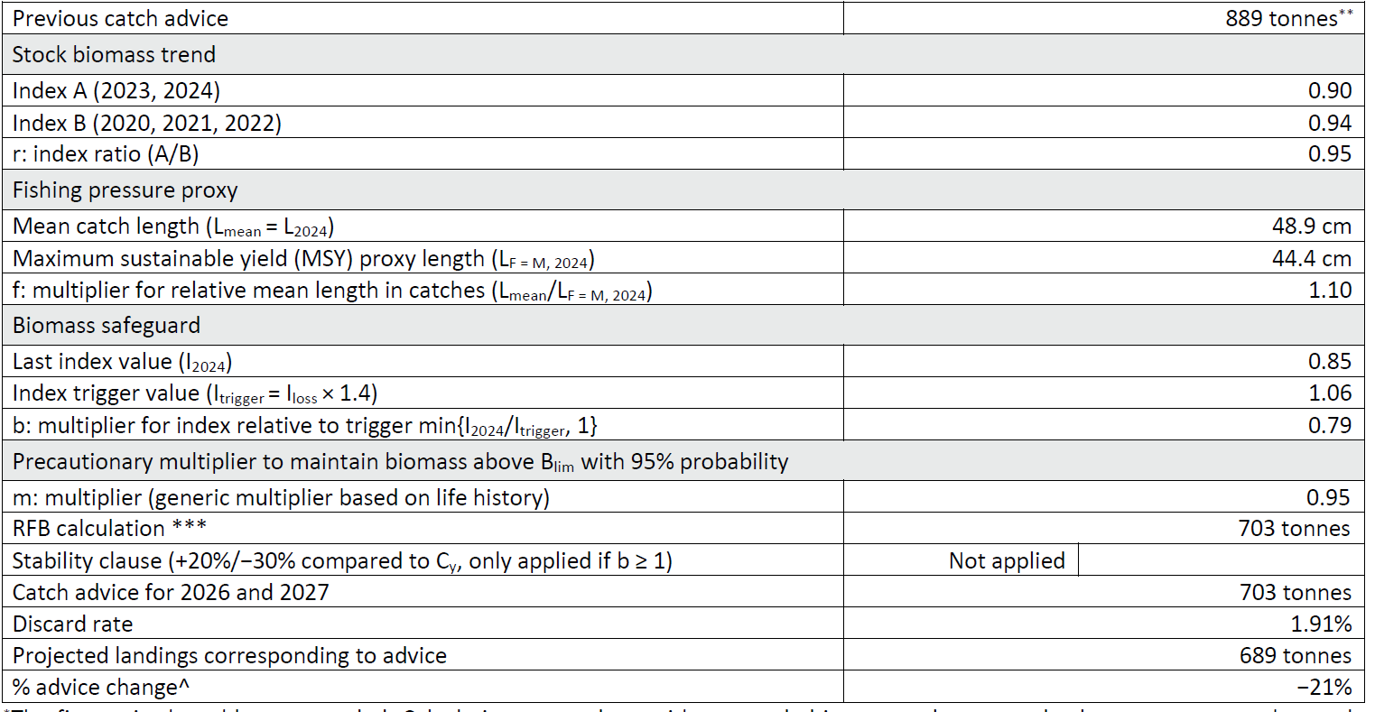
Pollack in Subarea 8 and Division 9.a (Bay of Biscay and Atlantic Iberian waters)
Catch (2024) : 945 t (does not include recreational catch)
rfb
A𝑦+1 = A𝑦 × 𝑟 × 𝑓 × 𝑏 × 𝑚

Slide 18
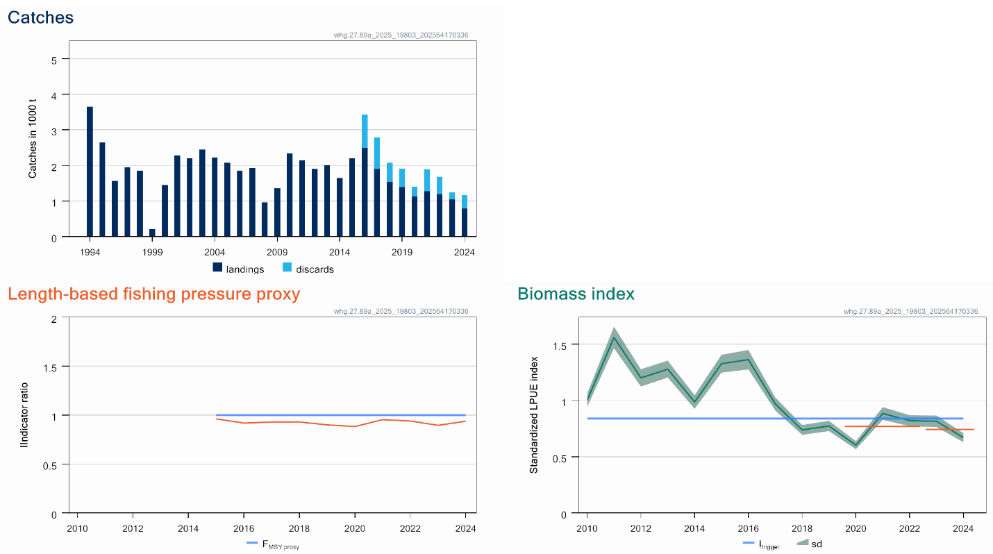
Whiting in Subarea 8 and Division 9.a (Bay of Biscay and Atlantic Iberian waters)
Advice for 2026 and 2027, MSY: Catch < 990 t -26%
Fishing pressure below FMSY proxy
Stock size indicator below trigger
Stock size declined further below the trigger

Slide 19
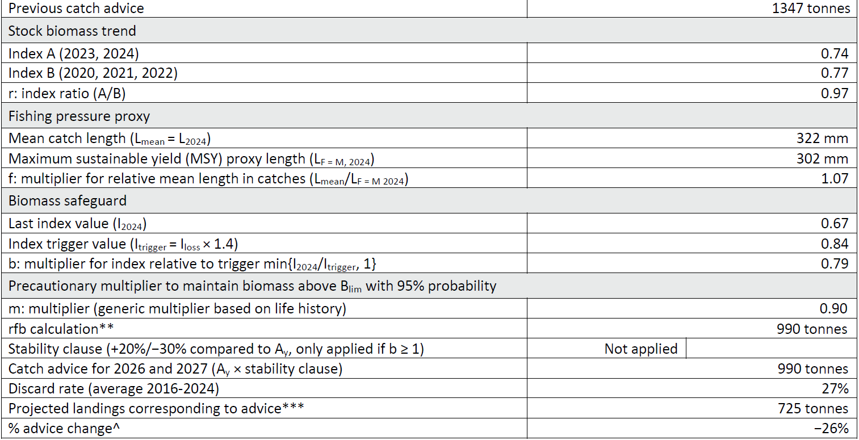
Whiting in Subarea 8 and Division 9.a (Bay of Biscay and Atlantic Iberian waters)
Catch (2024) : 1173 t (32% discards)
rfb
A𝑦+1 = A𝑦 × 𝑟 × 𝑓 × 𝑏 × 𝑚

Slide 20
Golfe de Gascogne

Slide 21
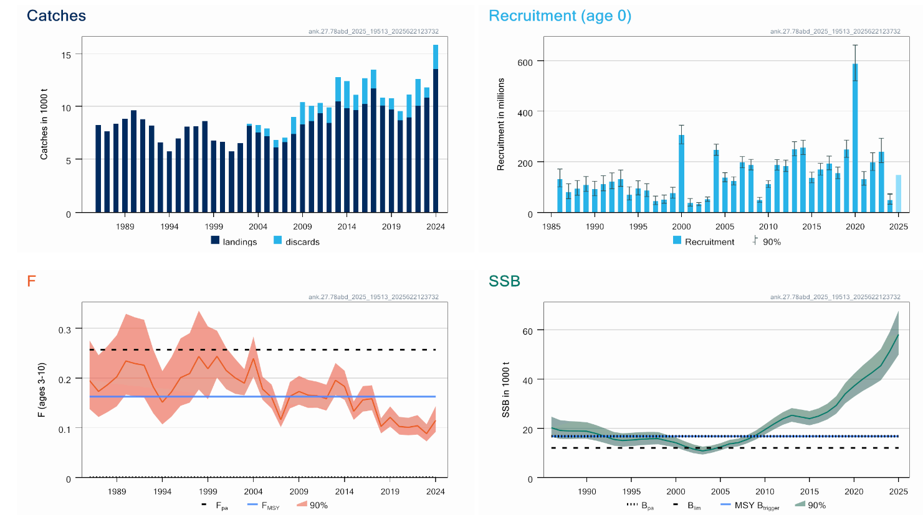
Black-bellied anglerfish in Subarea 7 and divisions 8a-b and 8d
Advice for 2026, MSY: Catch < 22 390 t advice -11.5%
F below F_{MSY}
SSB above MSY Btrigger
Two species not separated in landing statistics
TAC combined with white anglerfish
Downward revision in stock size - retrospective
Notes:
updated

Slide 22
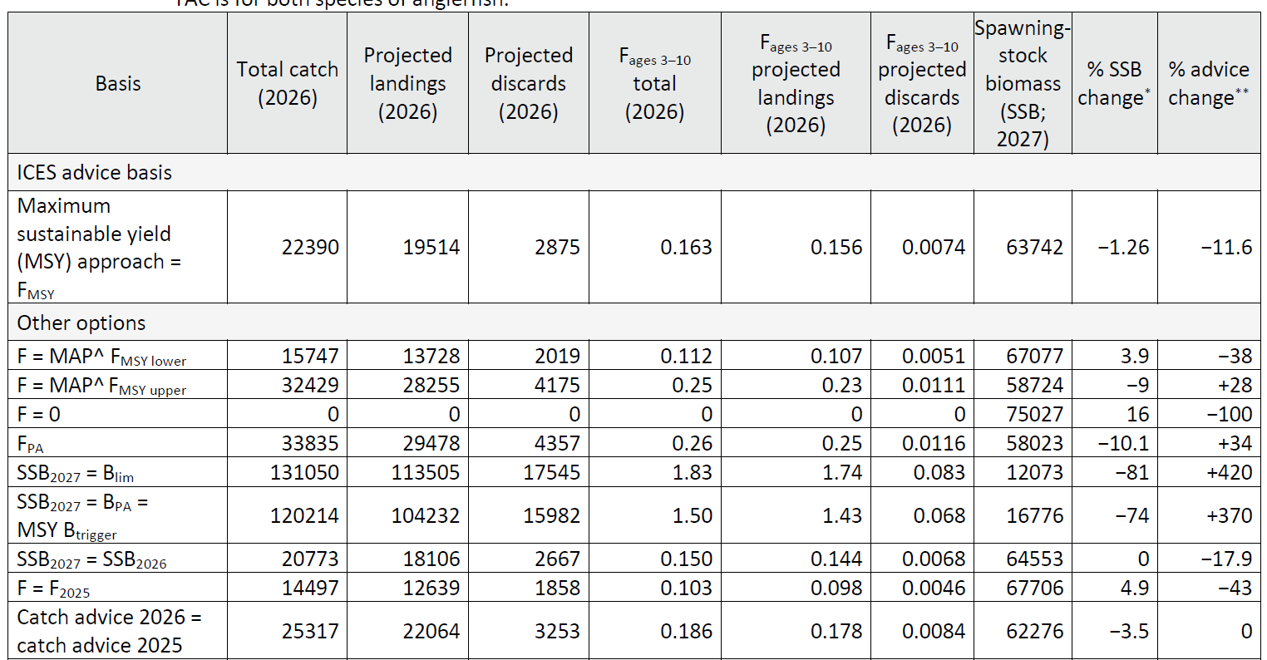
Black-bellied anglerfish in Subarea 7 and divisions 8a-b and 8d
Catch (2024) : 15 811 (14 % discards)
F(2025) = 0.103 (average F 2022-2024)
SSB(2026) = 64 553t > MSY_{Btrigger} (16 776t) F_{MSY}= 0.163
Length based age structured stock synthesis

Slide 23
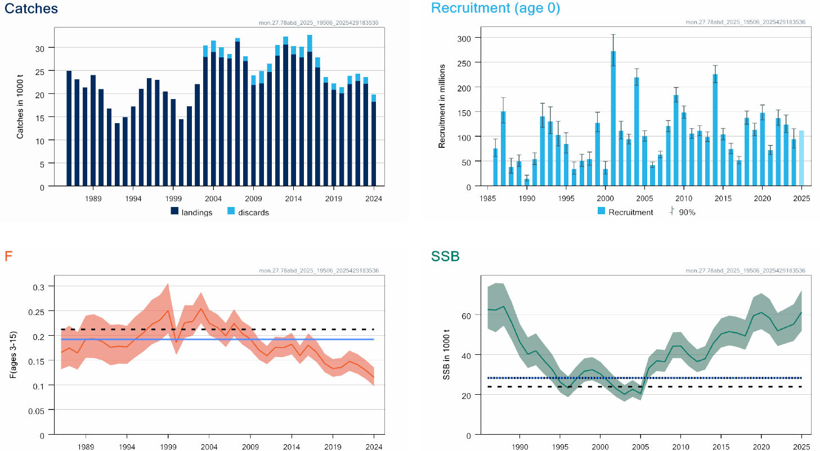
White anglerfish in Subarea 7 and divisions 8a-b and 8d
Advice for 2026, MSY: Catch < 36 090 t advice +3.2%
F below F_{MSY}
SSB above MSY Btrigger
TAC combined with black bellied anglerfish
Two species not separtated in catches
Increase in stock size
Notes:
Updated

Slide 24
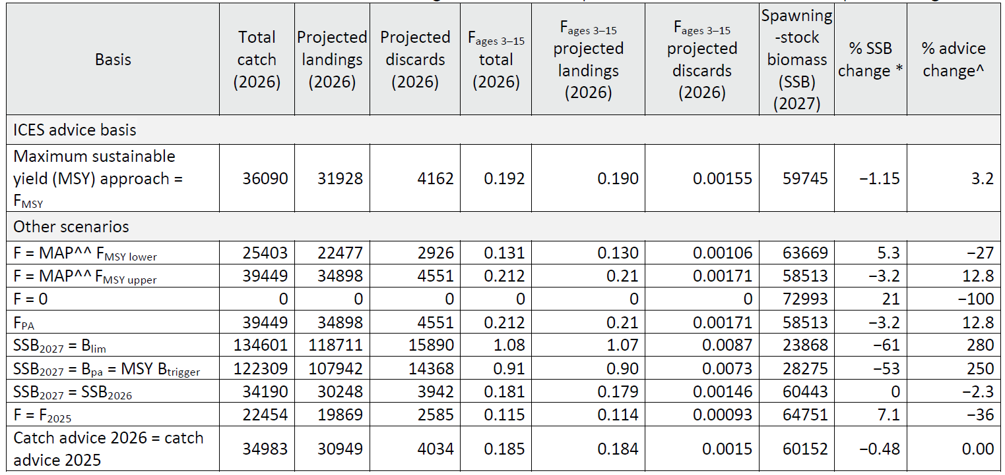
White anglerfish in Subarea 7 and divisions 8a-b and 8
Catch (2024) : 19 821 t (8 % discards)
F(2025) = 0.115 (average F 2022-2024)
SSB(2026) = 60 443 t > MSY_{Btrigger} (28 275 t) F_{MSY}= 0.192
Length based age structured stock synthesis

Slide 25
Megrim in the west and southwest of Ireland, Bay of Biscay (7.b–k, 8.a–b, and 8.d )
Advice for 2026:
Advice Delayed
Retrospective issue
Hope to release in autumn
Notes:
Updated

Slide 26
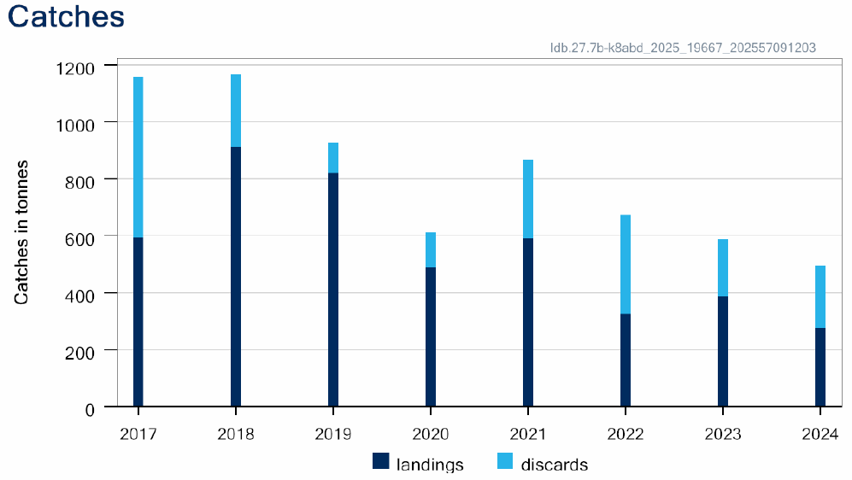
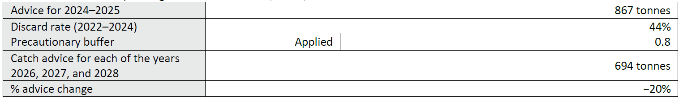
Four-spot megrim in divisions 7b-k, 8a-b and 8d
Advice for 2026, 2027 and 2028 : PA: catch ≤ 694t -20%
Can not assess status
PA buffer applied
Two species not separated in landing statistics
TAC combined with megrim

Slide 27
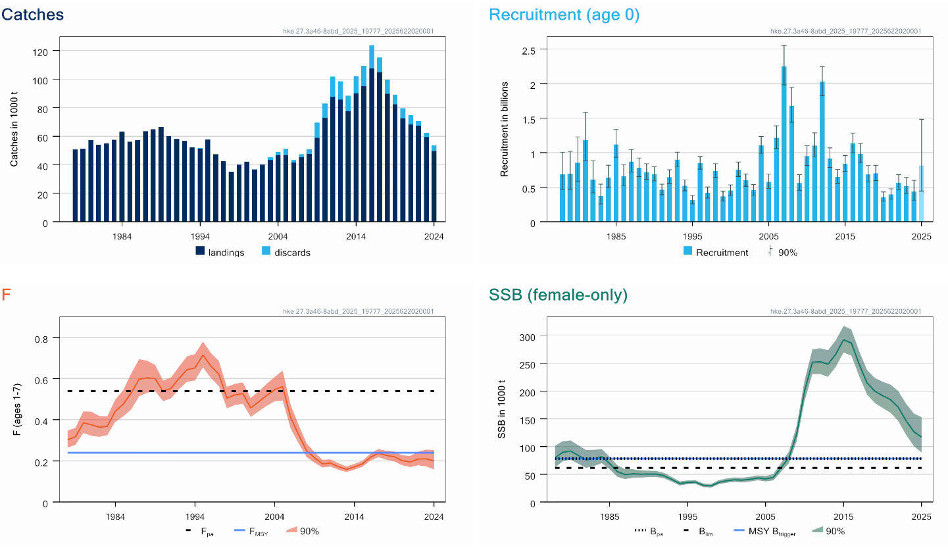
Hake – Northern stock (3.a, 4, 6, 7, 8.abd)
Advice for 2026: MSY: Catch < 54 912 t advice +4.7%
F below Fmsy
SSB above MSY B_{trigger} but decreasing
Upward revision of SSB and lower F in 2024 than assumed in last year’s forecast
Stock area does not correspond to the TAC areas

Slide 28
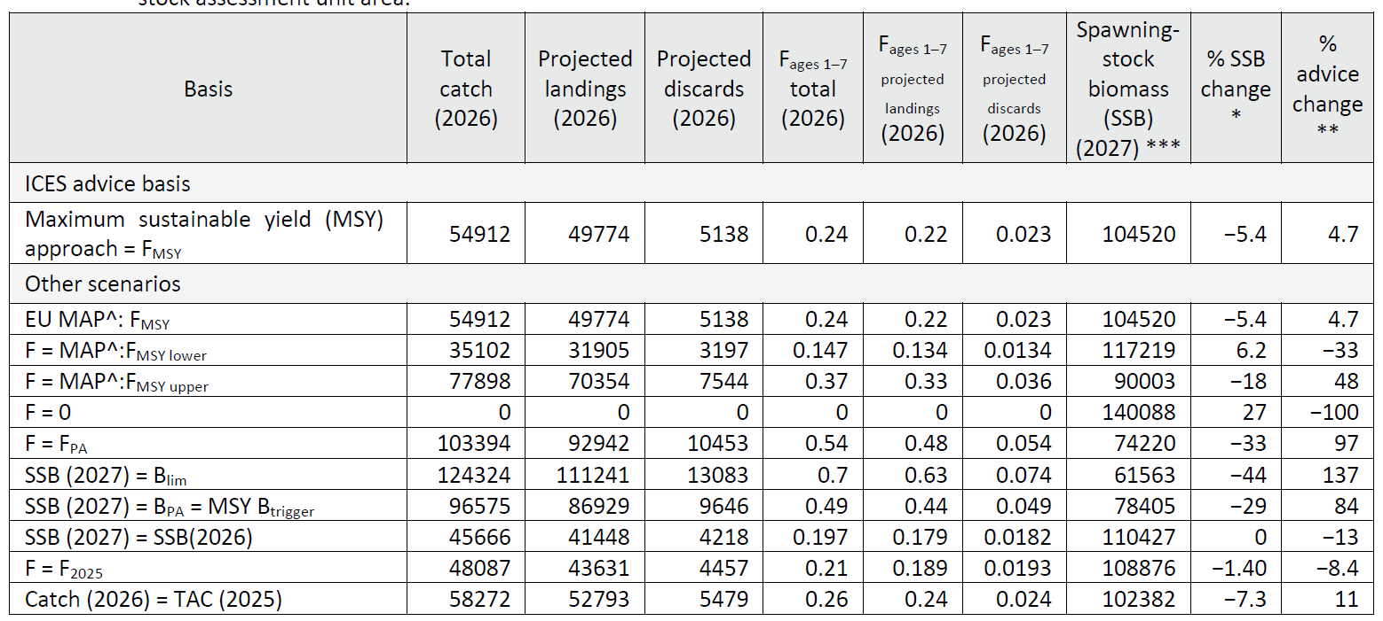
Hake – Northern stock (3.a, 4, 6, 7, 8.abd)
Catch (2024) : 53 733 t (7.7 % discards)
F(2025) = 0.23 (Average F ₂₀₂₂₋₂₀₂₄ )
SSB (2026)= 110 427 > MSY_{Btrigger} (78 405t) F_{MSY}= 0.24
Length based and sex disaggregated stock synthesis

Slide 29
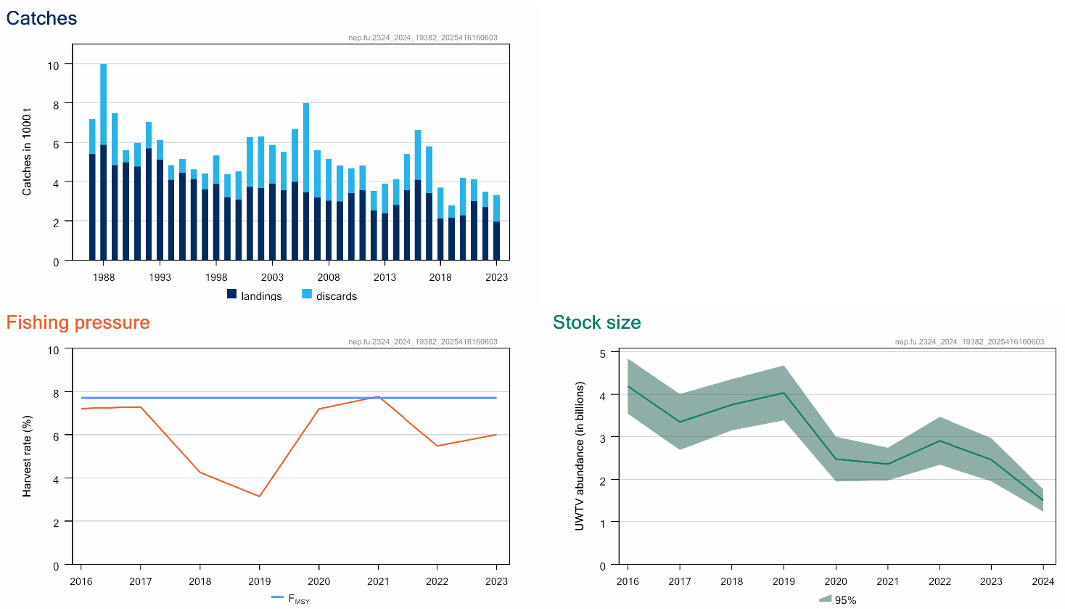
Nephrops FU 23-24 (divisions 8a and 8b)
Advice 2025: MAP < 2601 t -55%
Advice for 2026 will be released October
F below FMSY proxy
No biomass reference point
Decrease in stock size
UWTV survey
Advice revised in May 2025 – error in survey index
Notes:
updated

Slide 30
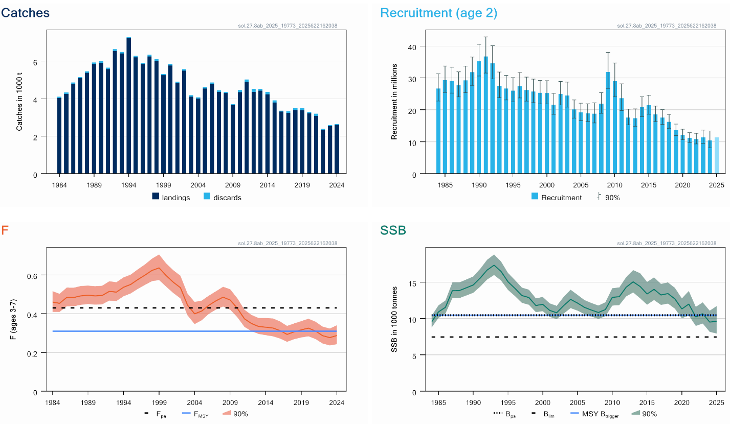
Sole in divisions 8a-b
Advice for 2026: EU MAP: Catch 1664-2482 t -1 to -3 % lower
F below F_{MSY}
SSB below MSY Btrigger
Notes:
updated

Slide 31
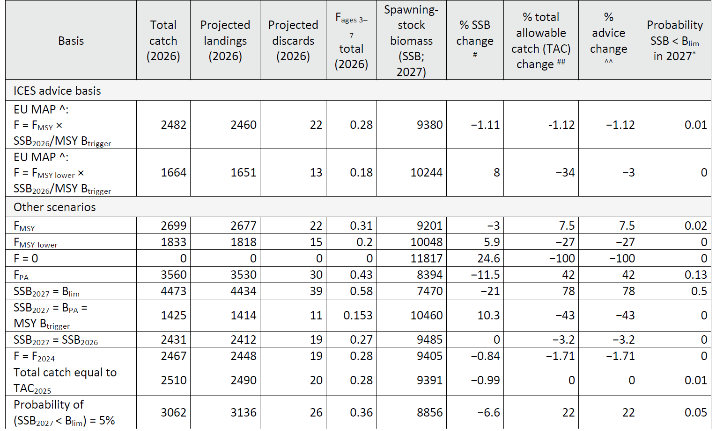
Sole in divisions 8a-b
Catch (2024) : 2 643 (2% discards)
F(2025) = 0.28 (average f 2022-2024)
SSB (2026)= 9 485 t < MSY_{Btrigger} (10 460) F_{MSY}= 0.31
SAM

Slide 32
Sea bass in divisions 8a-b
Advice for 2026: benchmark
WKBSEABASS
Including Stock ID workshop spanned from 2022 to early 2025
Two stocks
  Northern bss.27.4bc7d-h – central and southern North Sea, Irish Sea, English Channel, Bristol Channel and Celtic Sea
  Southern bss.27.8ab – northern and central Bay of Biscay
Stock ID
Recreational catch
Assessment models
Notes:
updated

Slide 33
Stock ID
Tagging, genetic, particle tracking, and isotope data highlighted substantial biological exchange between current ICES stock units.
Tagging data revealed mixing among Celtic Sea (divisions 7.f-h), English Channel (7.d-e) and Bay of Biscay (8a) sea bass, with a seasonal component – more during summer feeding
Less evidence of connectivity among Irish Sea (7.a) North Sea (4.b-c) and southern Bay of Biscay (8.b) sea bass.

Slide 34
Stock ID
Not enough information to produce full mixing model or to determine exact mixing between all stocks
But clear mixing between north and south
Mixing incorporated by moving catch from north to south
.
Landings in north from southern stock
comm rec
2023 316 358
2024 243 372

Slide 35
Recreational catch
Recreational catch a large part of the removals so important to get a good estimate
Used national surveys of recreational catch
  Belgium, Denmark, France (north), France (Biscay), Ireland, Netherlands, UK
  Retained and released separately
    Tonnage, number, length frequencies
  Time series – available years varied by country
3 workshops, extensive modelling and sensitivity analyses to determine best way to construct time series of recreational catch
95% post release survival

Slide 36
Assessment
Both stocks stock synthesis
For southern stock 23 different model formulations tested
Detailed diagnostics conducted on final formulation

Slide 37
Assessment 8ab
SS3
Catch
  Commercial landings and discards
  Recreational landings and releases (95% survival)
  Reallocation of both commercial and recreational from north to south
2 surveys
  French commercial LPUE
  Nourdem Loire survey
  Nourdem Gironde survey
M varies with age

Slide 38
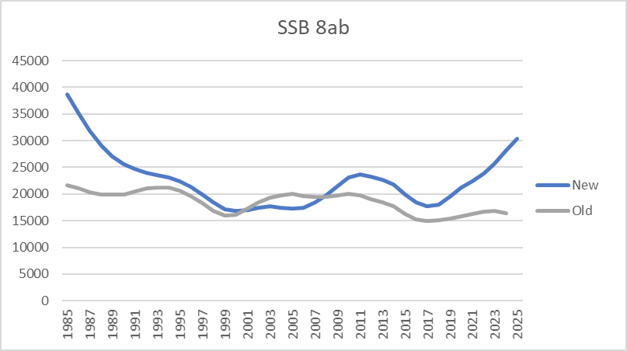
Assessment 8ab
Reference points updated

Slide 39
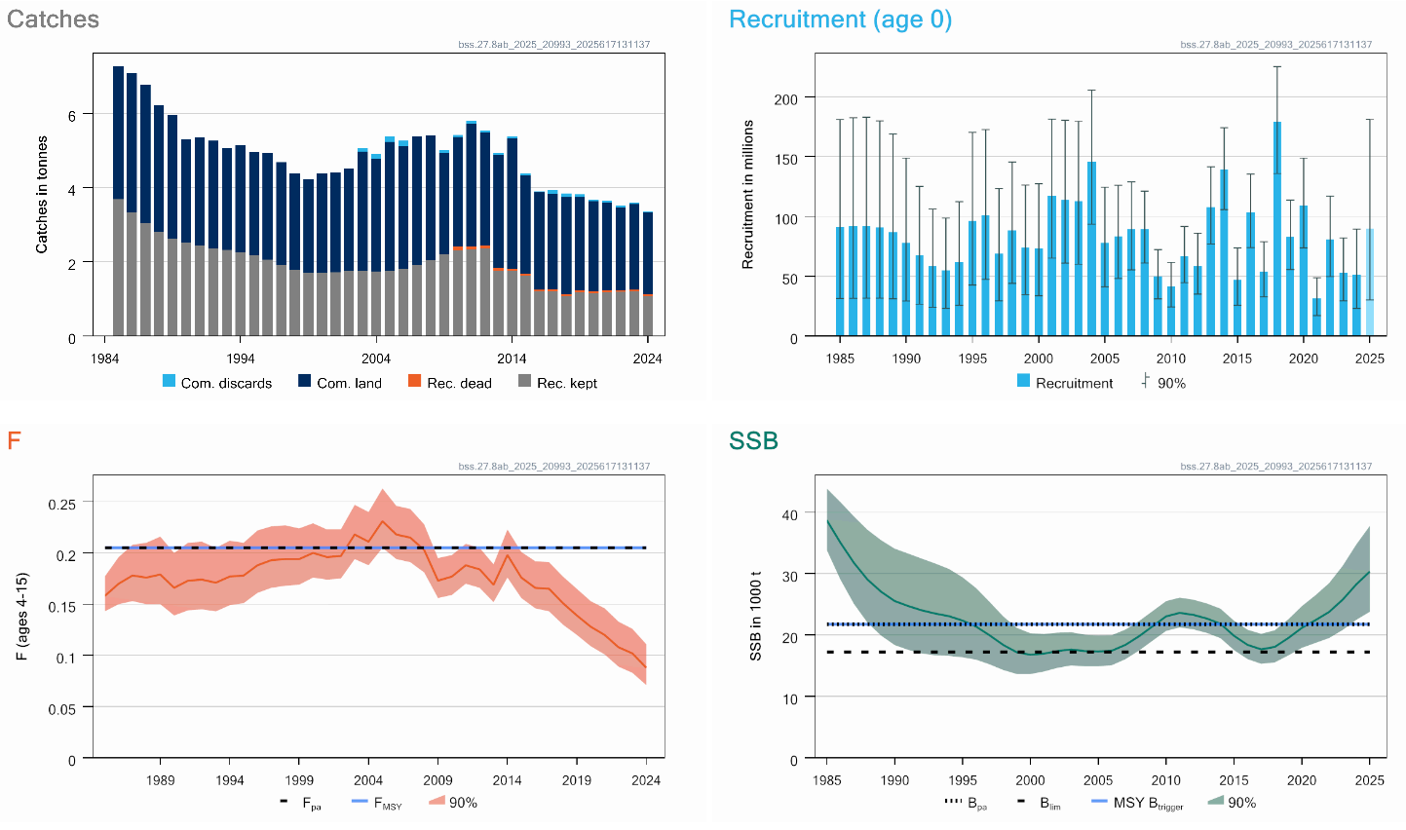
Sea bass in divisions 8a-b
Advice for 2026: EU MAP: total removals 6423-7618 t ~ +190%
F below F_{MSY}
SSB above MSY Btrigger
Change in perception after benchmark
Recreational data still uncertain – limited data
Notes:
updated

Slide 40
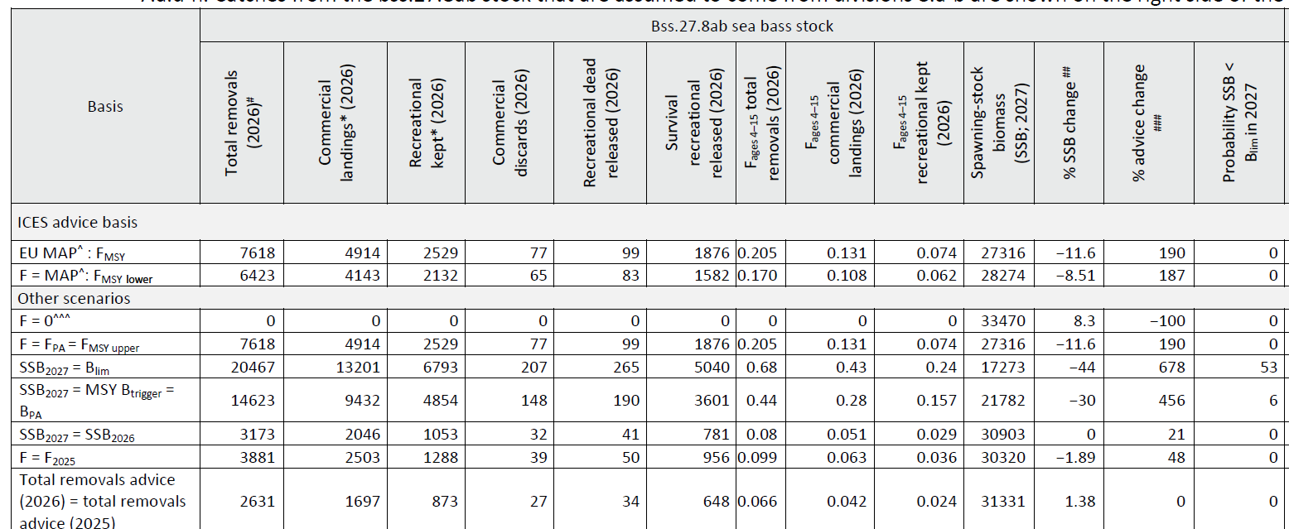
Sea bass in divisions 8a-b
Catch (2024) : 3216 t (1937 t commercial, 404 t comm. Discards, 749 rec kept, 115 t rec dead released
F(2025) = 0.099 Average F 2022-2024
SSB (2026)= 30903 > MSY_{Btrigger} (21782t) F_{MSY}= 0.205
No TAC in this area –technical measures
Age and length based stock synthesis including recreational catches

Slide 41
Eaux de la Péninsule Ibérique

Slide 42
Black-bellied anglerfish in divisions 8c and 9a
Advice for 2026: benchmarked 2025
WKBSS3
Examined
  Catch
  Indices (2 surveys SP-NSGFS-Q4 and SpGFS-GC-WIBTS-Q4, 1 commercial combining the LPUEs from SP-Trawl and PT-Trawl)
  Natural mortality (sex and age dependent)
  Growth
Tested a variety of combinations of these factors
Extensive diagnostics on chosen model
SS3 accepted (previously SPiCT)
Notes:
updated

Slide 43
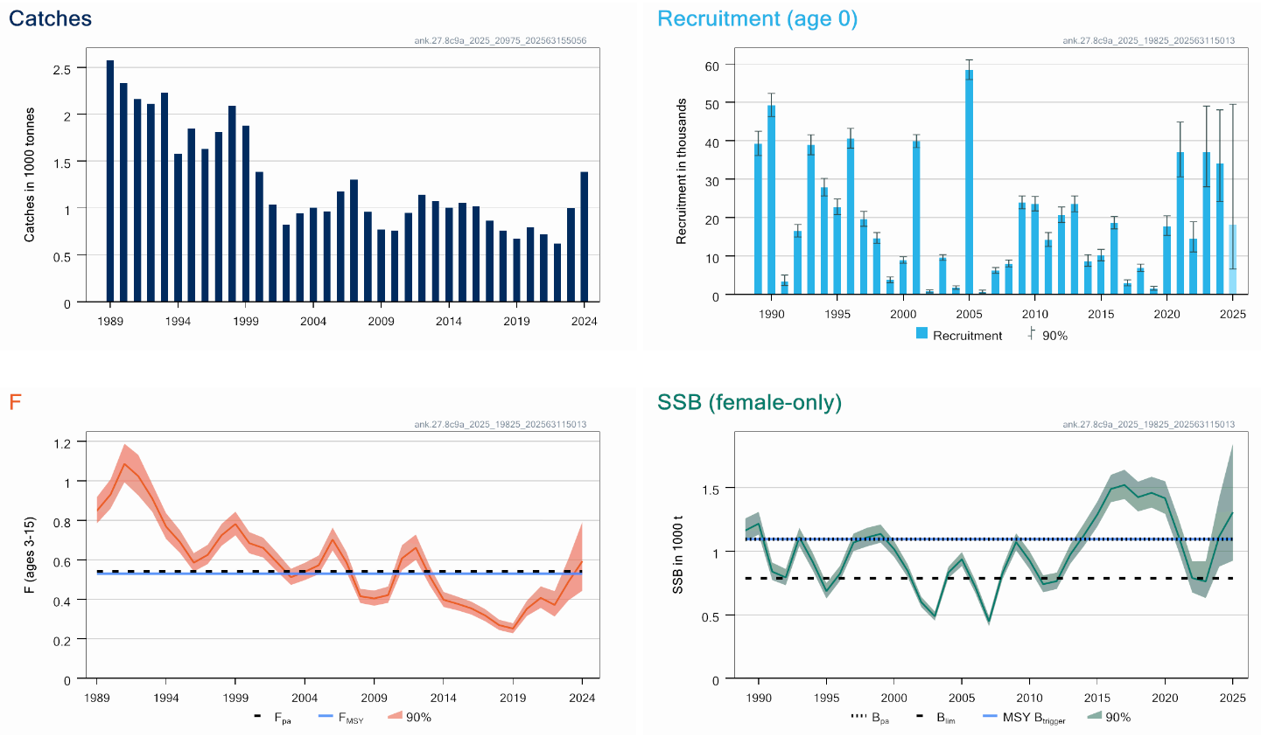
Black-bellied anglerfish in divisions 8c and 9a
Advice for 2026: MAP: Catch 1163 to 1751 t advice -31 to -53%
F above F_{MSY,} F_{PA}
SSB (female only) above MSY Btrigger
Two species not separated in landing statistics
TAC combined with white anglerfish
Notes:
updated

Slide 44
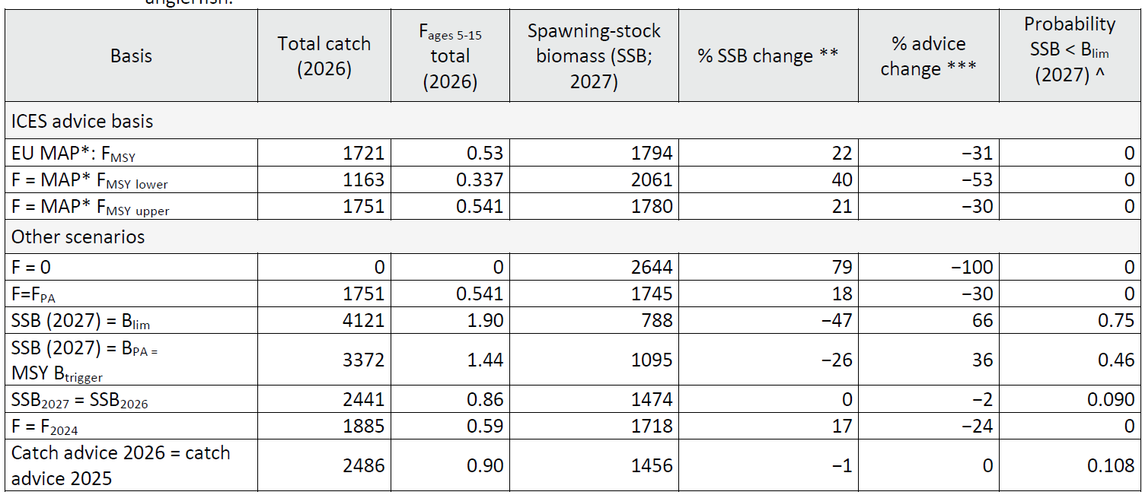
Black-bellied anglerfish in divisions 8c and 9a
Catch (2024) : 1383t (negligible discards)
F(2025) = 0.59 (average exploitation pattern 2022-2024, scaled to F2024)
Biomass (2026)= 1474 t >MSY_{Btrigger} 1095 t FMSY=0.53
SS3

Slide 45
White anglerfish in divisions 8c and 9a
Advice for 2026: benchmarked
WKBSS3
Examined
  Catch
  Indices (2 surveys Spanish North Coast Bottom Trawl Survey and two commercial indices (standardized LPUE series from SP-TRAWLERS and standardized SP-CEDGNS8c, no change but examined some others )
  Natural mortality (sex and age dependent, change)
  Growth
Tested various combinations of these factors
Extensive diagnostics on final model
SS3 – updated from previous SS3
Notes:
updated

Slide 46
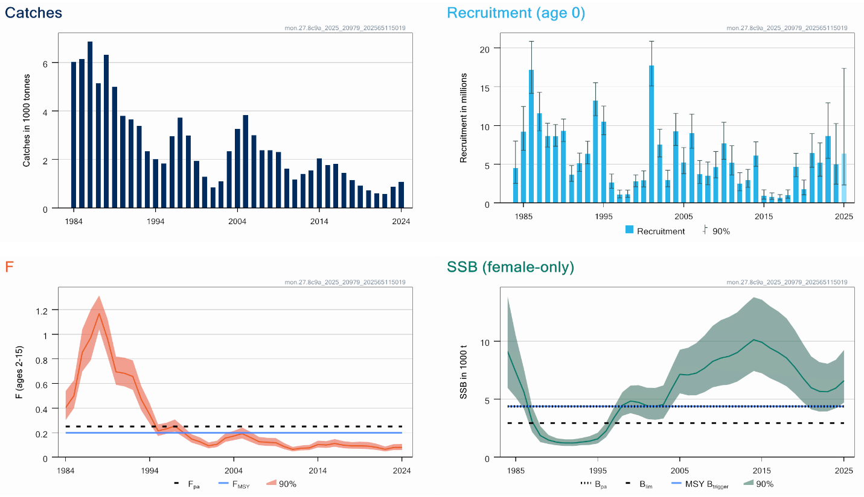
White anglerfish in divisions 8c and 9a
Advice for 2026: EU MAP: Catch 2721 – 4428 t advice +15 to +30%
F below F_{MSY}
SSB above MSY Btrigger
Advice higher – result of benchmark
No index for older fish
Notes:
updated

Slide 47
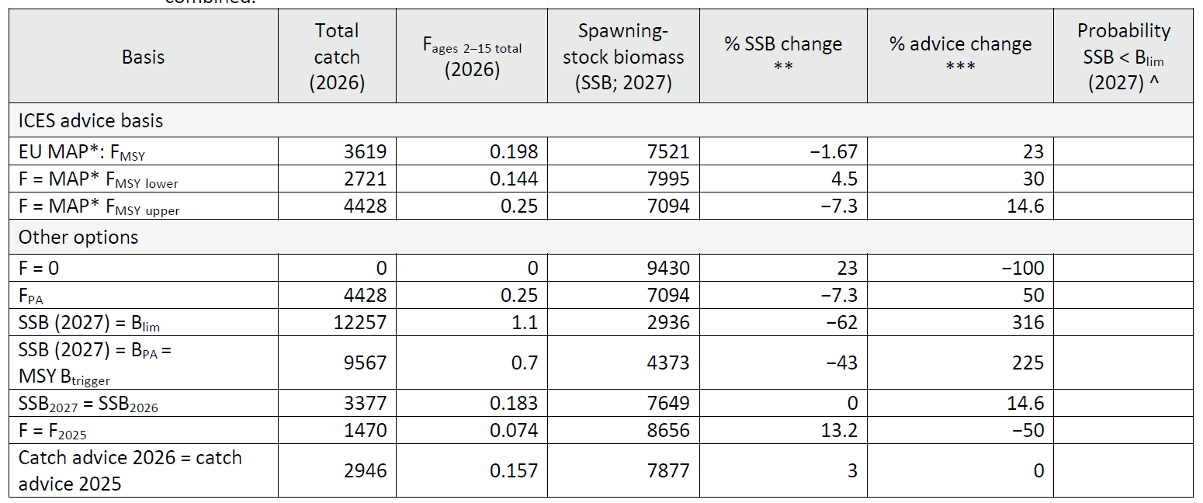
White anglerfish in divisions 8c and 9a
Catch (2024) : 1079 t (negligible discards)
F(2025)=0.074 (Average 2022-2024)
SSB(2026)= 7649 t >MSY_{Btrigger} (4373 t) F_{MSY} =0.198
Two species not separated in landing statistics
TAC combined with black-bellied anglerfish

Slide 48
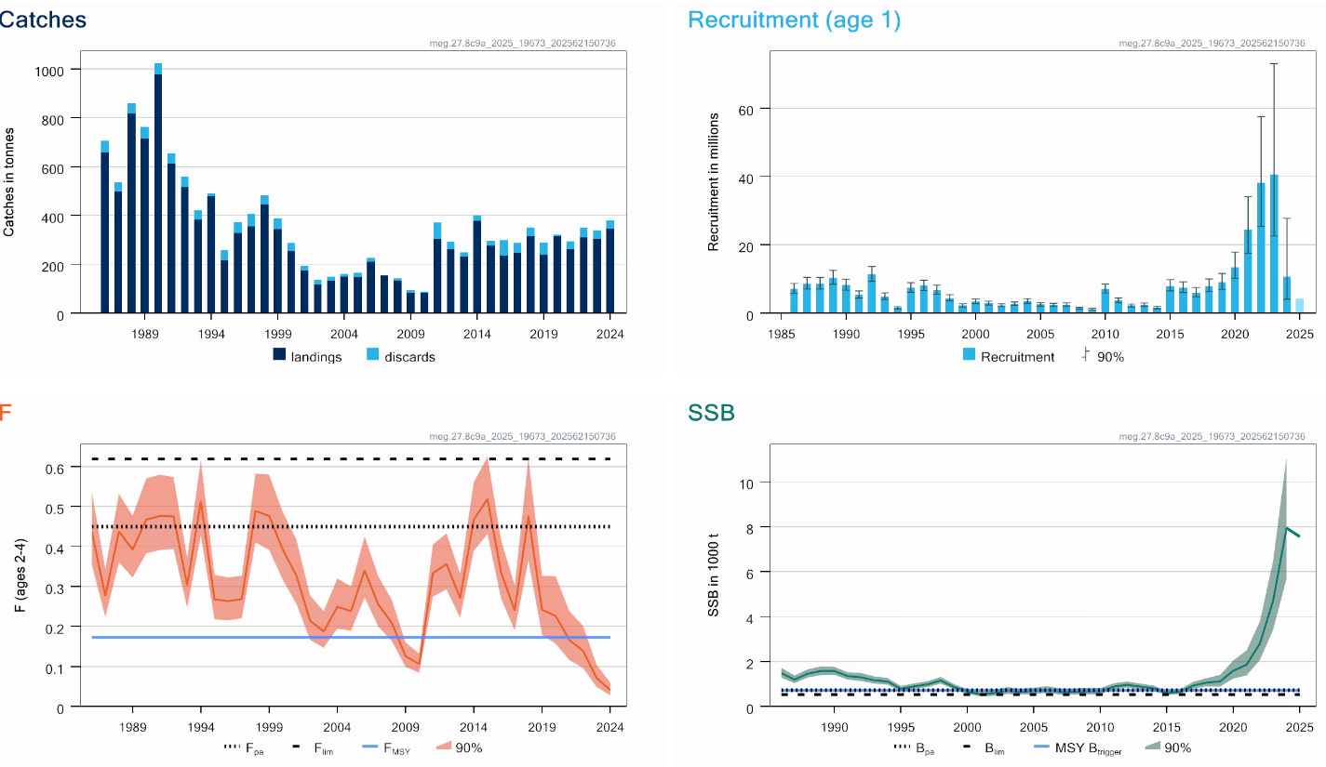
Megrim in divisions 8c and 9a
Advice for 2026: EU MAP: Catch 1458 – 3257 t advice ~+26%
F below F_{MSY}
SSB above MSY Btrigger
Two species not separated in landing statistics
TAC combined with four spot megrim
Increase advice: upward revision ages 1-4 (retrospective)
Notes:
updated

Slide 49
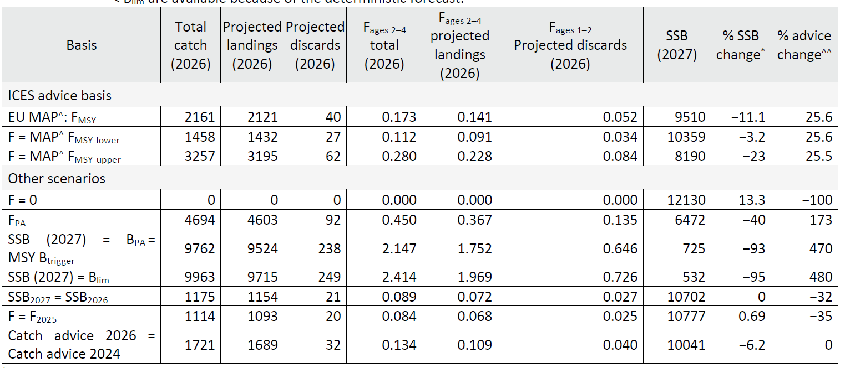
Megrim in divisions 8c and 9a
Catch (2024) : 379 t (8.7% discards)
F(2025)=0.084 (Average 2022-2024)
SSB(2026)= 10702 t >MSY_{Btrigger} (725 t) F_{MSY} =0.173
A4A
A4A age based assessment

Slide 50
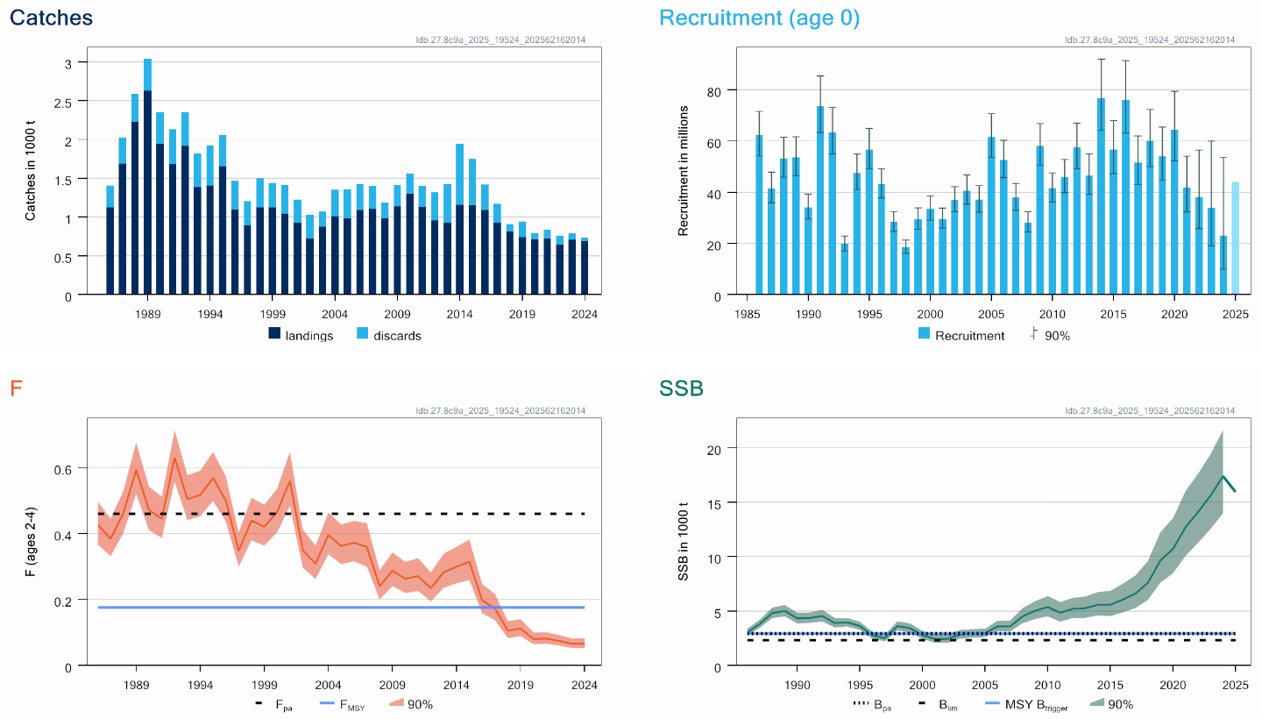
Four-spot megrim in divisions 8c and 9c
Four-spot megrim in divisions 8c and 9a
Advice for 2026: EU MAP: Catch 1973– 4244 t advice ~+4%
F below F_{MSY}
SSB above MSY Btrigger
Two species not separated in landing statistics
TAC combined with megrim
Notes:
updated

Slide 51
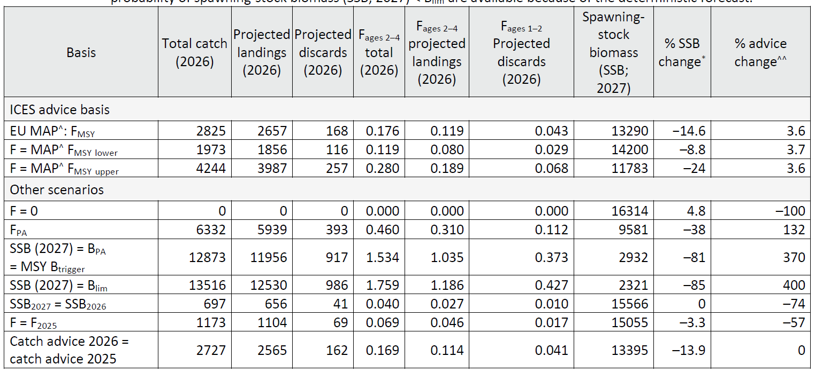
Four-spot megrim in divisions 8c and 9a
Catch (2024) : 736 t (7% discards)
F(2025)=0.069 (Average exploitation pattern 2020-2024, scaled to 22-24)
SSB(2026)= 15 566t >MSY_{Btrigger} (2932 t) F_{MSY} =0.176
A4A age based assessment

Slide 52
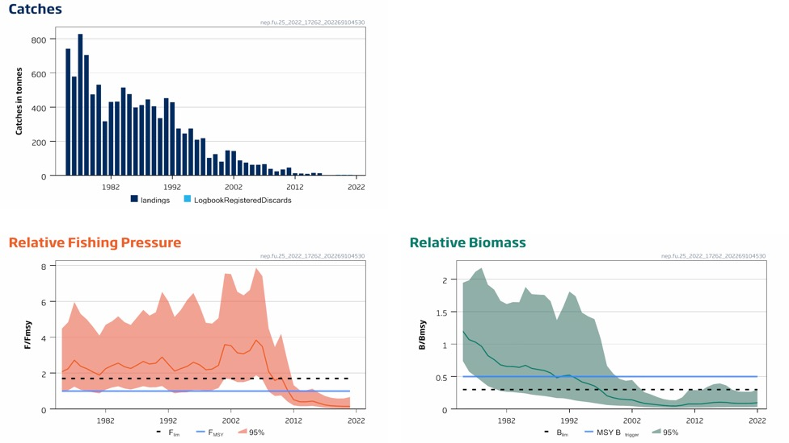
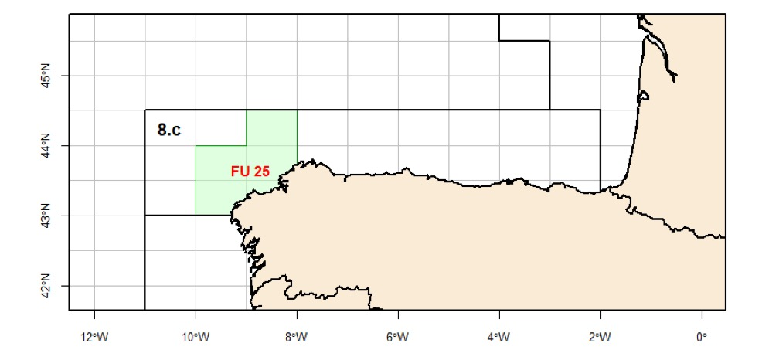
Nephrops in division 8c FU 25
Advice for 2023, 2024, 2025: MSY: Catch= 0 t No change
Advice released 2022
New advice autumn 2025
Fishing pressure below F_{MSY}
Spawning stock below B_{lim}
No catch scenario that will rebuild the stock above B_{lim} by 2025

Slide 53
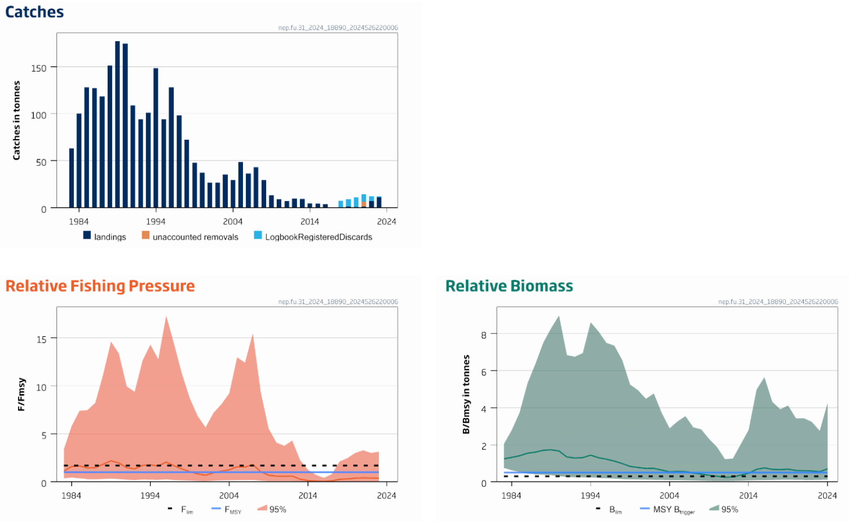
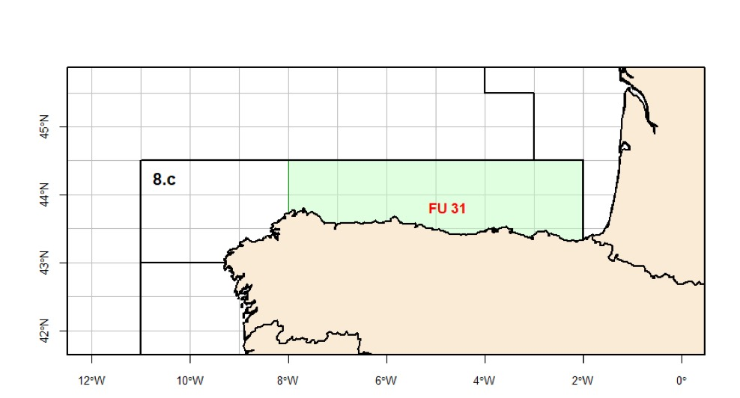
Nephrops in division 8c FU 31
Advice for 2025: MSY: Catch < 29 t advice +134%
Advice released 2024
New advice autumn 2025
Fishing pressure below F_{MSY}
Biomass above MSY Btrigger
Index of stock size used in model updated – now covers whole stock area
Notes:
updated

Slide 54
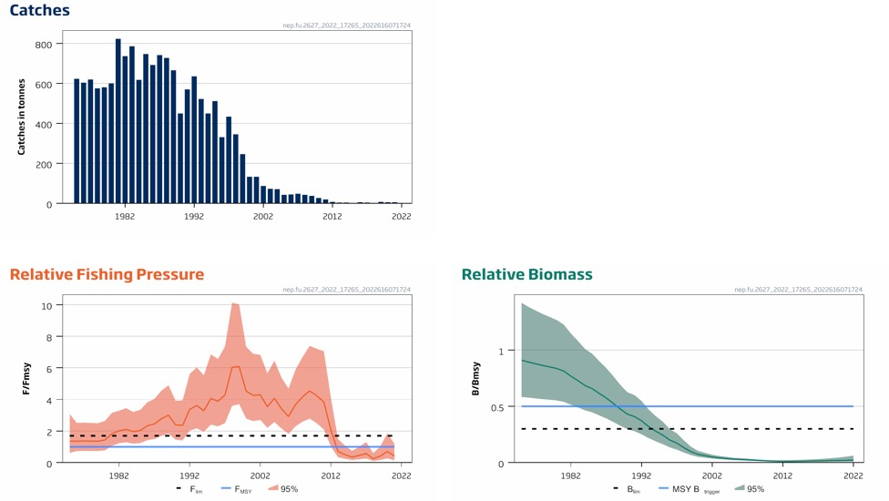
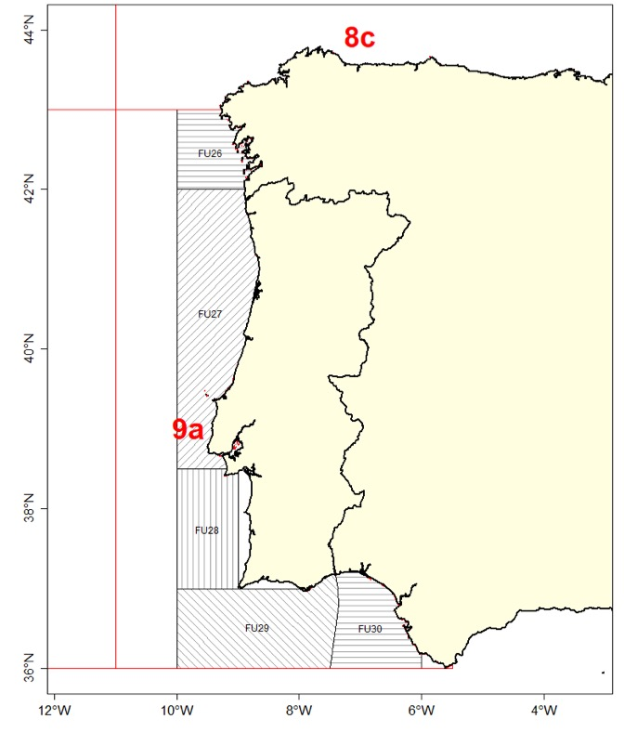
Nephrops in division 9a FU 26-27
Advice for 2023, 2024 and 2025: MSY: Catch= 0 t no change
Fishing pressure below F_{MSY}
Spawning stock below B_{lim}
No catch scenario that will rebuild the stock above B_{lim} by 2025
Advice released 2022
New advice autumn 2025

Slide 55
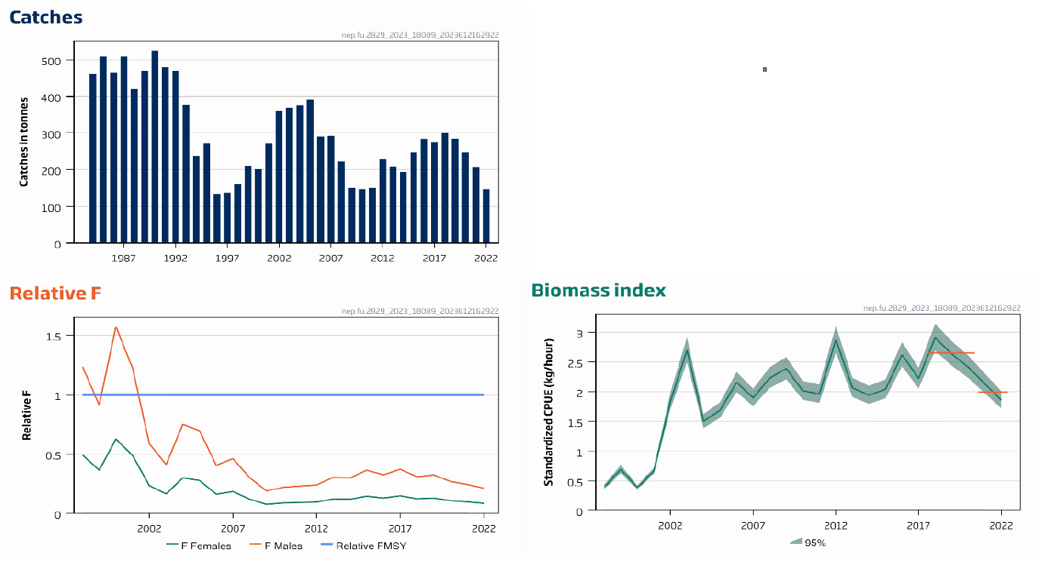
Nephrops in division 9a FU 28-29
Advice for 2024 and 2025: PA: Catch< 213 t -20%
Fishing pressure below F_{MSY}
No biomass ref pt
Advice lower: decline in biomass trend – uncertainty cap applied
Advice released 2023
New advice autumn 2025

Slide 56
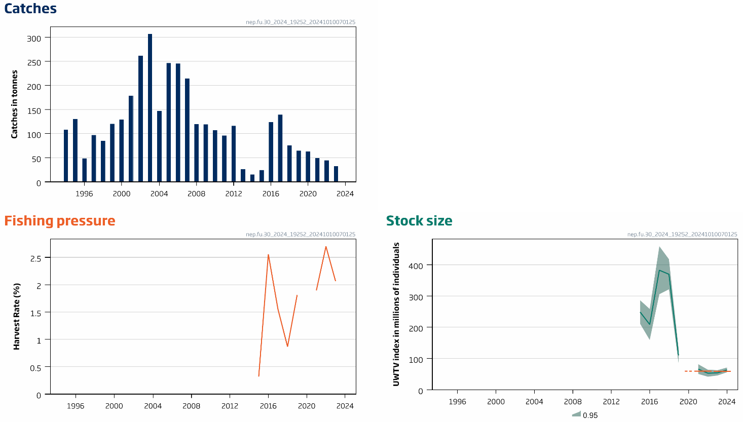
Nephrops in division 9a FU 30
Advice for 2025: PA: Catch< 26 t 0%
No reference points
Fishing pressure variable
Catch 2023 33 t
Advice from 2024
Advice release for 2026 – autumn 2025
Notes:
updated

Slide 57
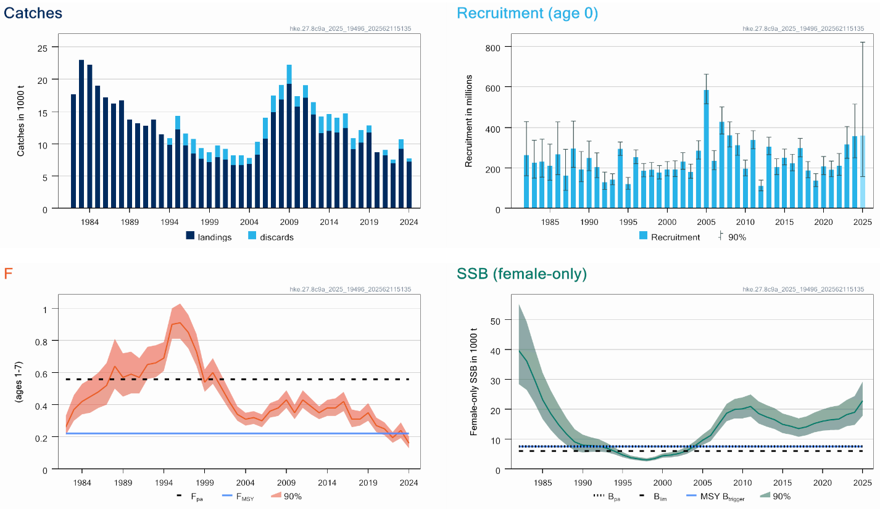
Hake in division 8c and 9a: southern stock
Advice for 2026: EU MAP: Catch 10 526 – 20 125 t advice ~ -1.3%
SSB females only
F below F_{MSY}
SSB above MSY Btrigger
Small decrease in advice despite increase in stock size – downward revision in biomass
Notes:
updated

Slide 58
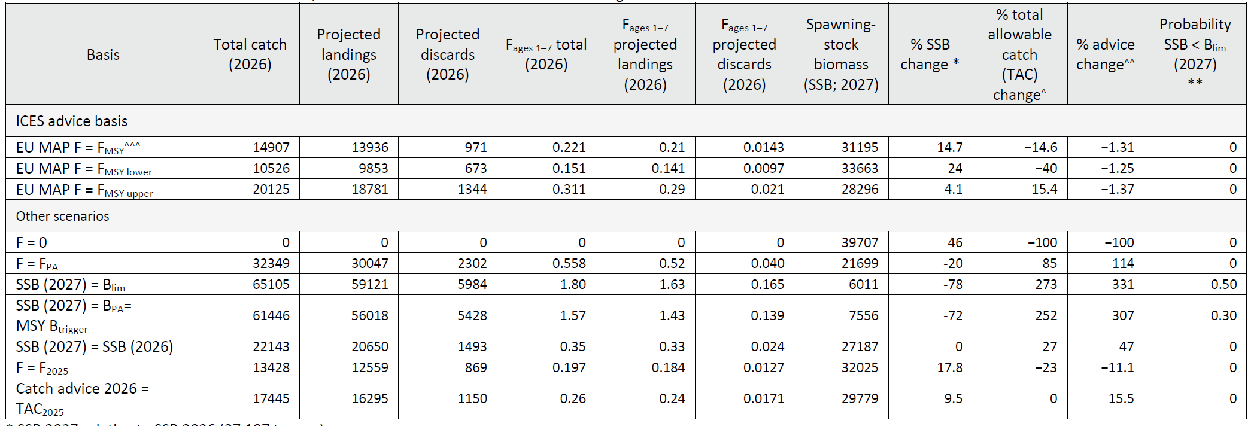
Hake in division 8c and 9a: southern stock
Catch (2024) : 7750 t (7% discards)
F(2025)=0.197 (Average 2022-2024)
SSB(2026)= 27 187 t >MSY_{Btrigger} (7556 t) F_{MSY} =0.221
Length based and sex disaggregated stock synthesis

Slide 59
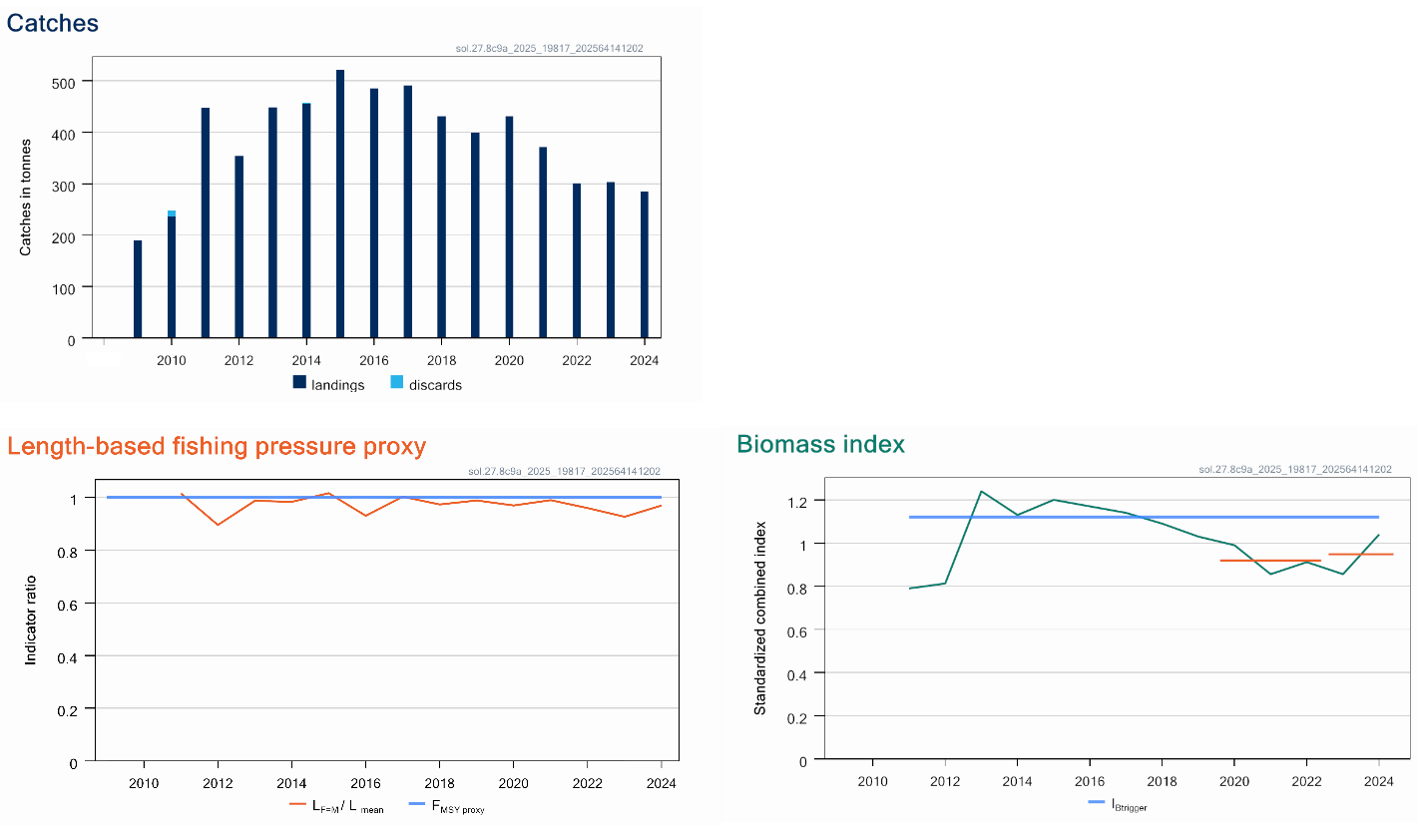
Sole in division 8c and 9a
Advice for 2026 and 2027: MSY: Catch < 190 t -9.1%
F below F_{MSY}
Stock size increased but below Itrigger
Decrease in advice: below trigger so biomass safeguard below 1
All sole species under single TAC

Slide 60
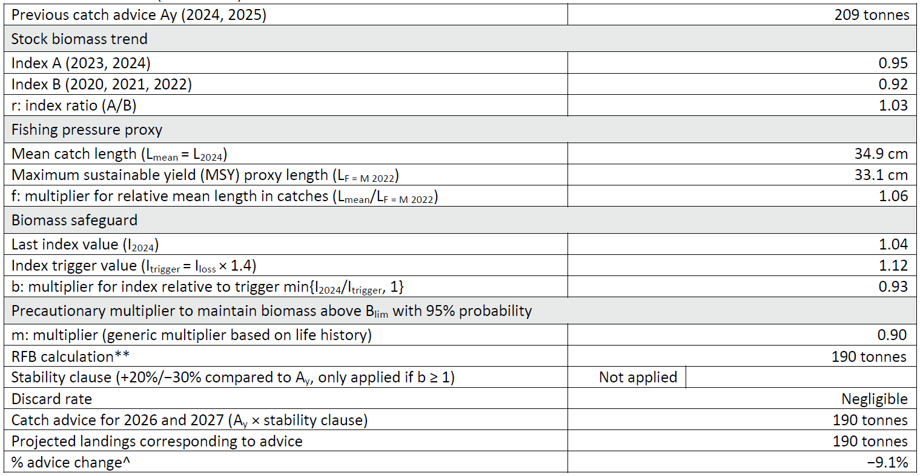
Sole in division 8c and 9a
Catch (2024) : 285 t (negligible discards)
rfb rule
Ay+1 = Ay × r × f × b × m

Slide 61
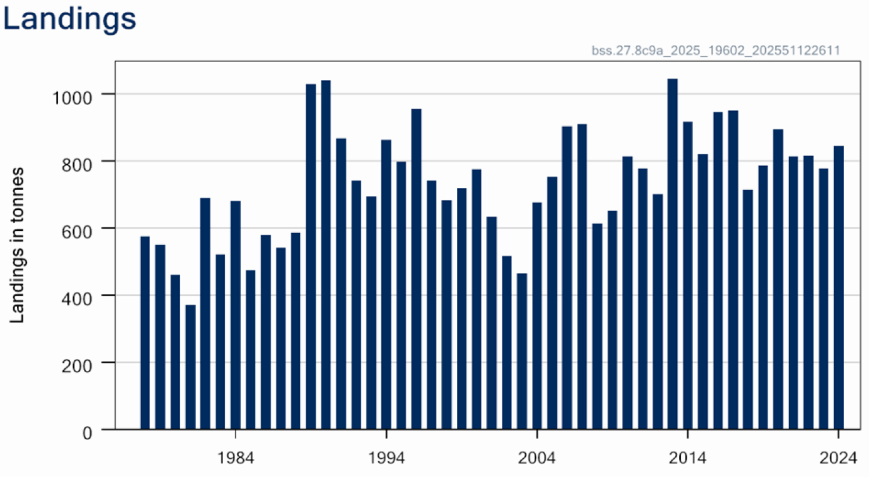
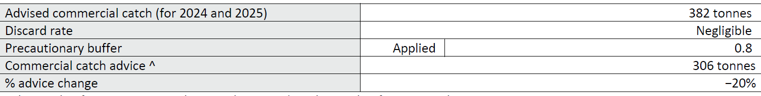
Sea bass in division 8c and 9a
Advice for 2026, 2027 and 2028: PA: Catch < 306 t no change
Category 5
Can not assess status
PA buffer applied
Recreational catch substantial but unquantified
No TAC in this area
Landings 2024 846 t

Slide 62

Thank you for your attention!
Joanne.morgan@ices.dk
www.ices.dk

Slide 63
ICES Assessment Categories
Category 1 – Stocks with quantitative assessments; includes stocks with full analytical assessments and forecasts that are either age-/length-structured or based on production models.
Category 2 – Stocks with analytical assessments and forecasts that are only treated qualitatively as well as stocks with surplus production models, e.g. SPiCT, JABBA, without an MSE;
Category 3 – Stocks for which survey-based assessments or exploratory assessments indicate trends; includes stocks for which survey, trends-based assessment, or other indices and life history information are available
Category 4 – Nephrops stocks where information on possible abundance can be inferred and stocks for which a reliable time-series of catch can be used to approximate MSY.
Category 5 – Stocks for which either only data on landings or a short time-series of catch are available
Category 6 –Stocks for which there are negligible landings and stocks caught in minor amounts as bycatch

