Slide 1

ICES advice
Réunion du Conseil Consultatif des eaux
Occidentales australes-CC-SUD
July 2025
Horse mackerel and Anchovy
Joanne Morgan
ICES ACOM vice-chair

Slide 2
Horse Mackerel in division 9a
Advice for 2026: Benchmark 2024 – used in advice for 2025
WKBHMB
Examined
  Stock ID- genetics study indicates mixing with Western but insufficient information to change the stock definition at this time
  Catch – some revisions – considered more precise
  Biology
    Weight at age
    Natural mortality – varying with age
    Maturity
Indices – DEPM, combined survey (Spanish North Coast Bottom Trawl Survey and Portuguese International Bottom Trawl Survey), commercial bottom trawl CPUE index
Notes:
updated

Slide 3
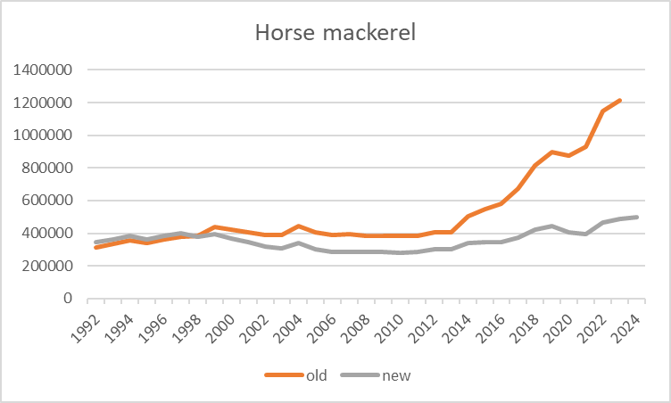
Horse Mackerel in division 9a
Advice for 2026: Benchmark 2024 – used in advice for 2025
Stock Synthesis (SS) – previously AMISH (made specifically for this stock)
10 different model formulations examined
Extensive diagnostics of final formulation
New reference points
Notes:
updated

Slide 4
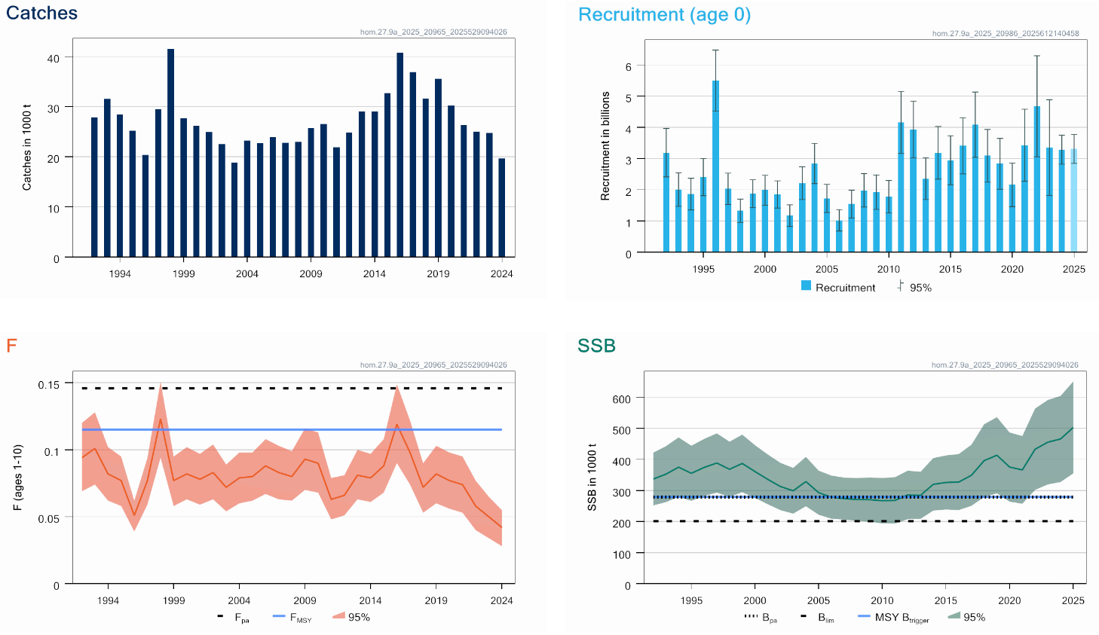
Horse Mackerel in division 9a
Advice for 2026: MSY: Catch < 56 520 t advice -5%
F below FMSY
SSB above trigger
Second advice with the new model
Slight downward revision in stock size
No survey for 2024
TAC is for several Trachurus species
Notes:
updated

Slide 5
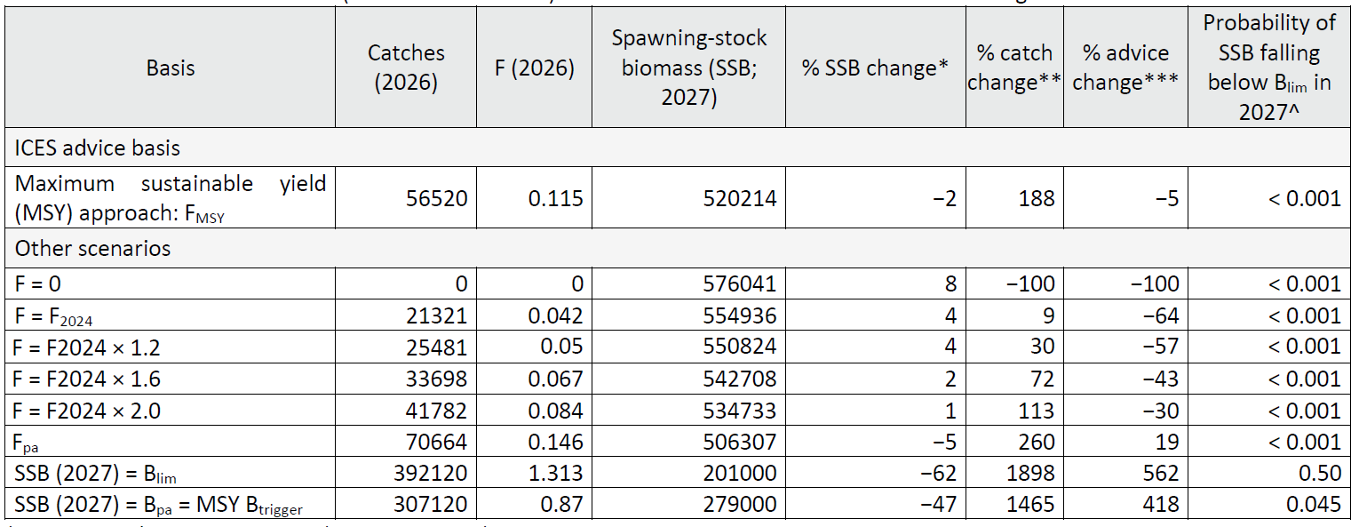
Horse Mackerel in division 9a
Catch (2024) : 19 628 t (negligible discards)
F(2025) = 0.042 (F 2024)
SSB(2026) = 531 281 t > MSY_{Btrigger} (279 000 t) F_{MSY}= 0.115
SS3

Slide 6
Anchovy in division 9a
Benchmarked 2024
Stock ID major issue
  spatial distribution assessed in surveys and catches
  variability of life-history traits
  morphometric and genetic analysis
  new data on genomics of anchovy in the area of distribution and contiguous areas
  new data of modelling of larval dispersal in Iberian waters
  new data of stable isotopic analysis of eye lenses.
Conclusion: 9aS and 9aW separate
Notes:
updated

Slide 7
Anchovy in division 9aS
Benchmarked 2024
Examined
  Catch
  Indices – 4 surveys PELAGO, BOCADEVA, ECOCADIZ and ECOCADIZ-RECLUTAS (age 0)
  Weight at age, natural mortality, maturity
  SS3 (GADGET used previously as index) BUT Fcap not defined so SS3 still used as index (need an MSE to define Fcap, pending its completion – 1 over 2 rule)
  Tested 30 model formulations
  Diagnostics for final model
Important note: decision that assessment should be conducted as close in time to survey indices as possible – advice given at end of year – advice for 2025 replaced in December 2024
Notes:
updated

Slide 8
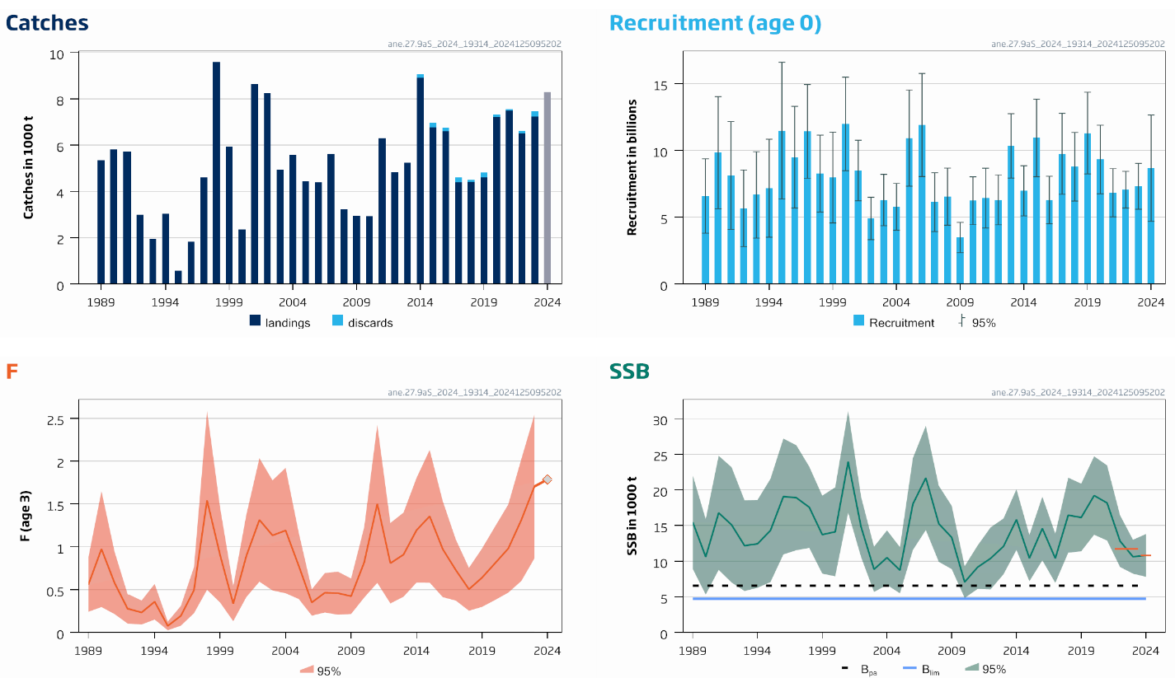
Anchovy in division 9aS
Advice for 2025: MSY: Catch < 7 266 t (change in advice period)
No F reference points
SSB above trigger
Advice 2026 December
Notes:
updated

Slide 9
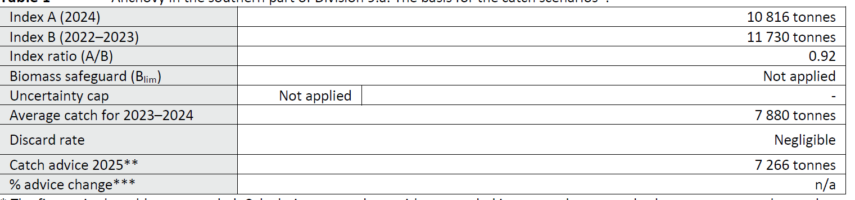
Anchovy in division 9aS
Catch (2024) : 7 469t (3% discards)
1 over 2 rule applied to average catch 2023-2024 as advice period has changed

Slide 10
Anchovy in division 9aW
Benchmarked 2024
Examined
  Mainly surveys – acoustic
    PELACUS, PELAGO, IBERAS, JUVESAR
    Looked at intra and inter survey consistency as well as survey coverage
    Result – combined index using PELACUS and PELAGO
Kept the category 3 CHR which is tuned specifically for this stock using MES
Important note: decision that assessment should be conducted as close in time to survey indices as possible – advice given in June for 01 July 2025-30 June 2026
Notes:
updated

Slide 11
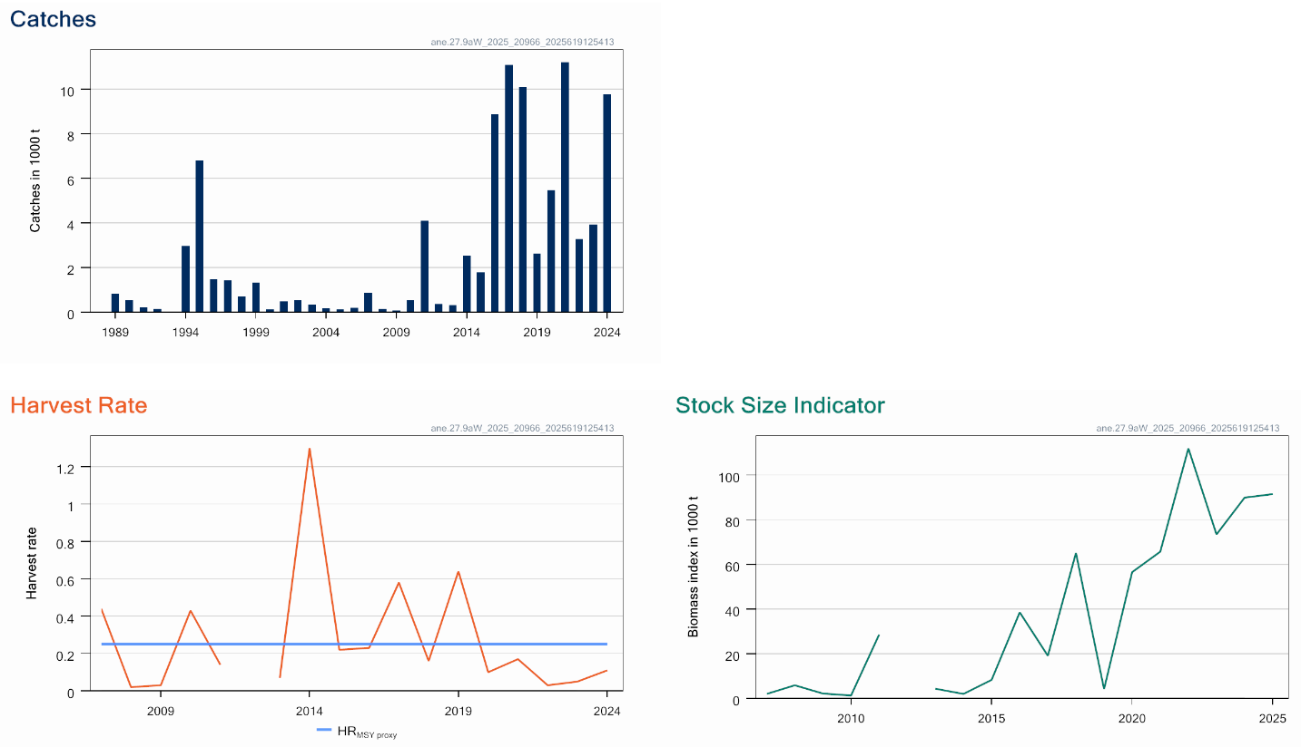
Anchovy in division 9aW
Advice for 1 July 2025 – 30 June 2026: MSY: catch < 22 871 +1.7%
F below proxy
No stock size reference points
Notes:
updated

Slide 12
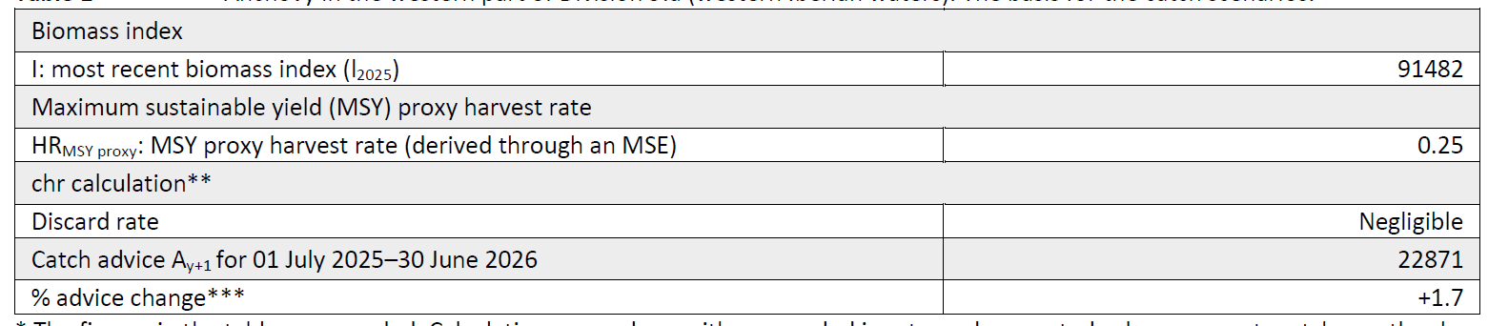
Anchovy in division 9aW
Catch (2024) : 5 935 t (negligible discards)
CHR: Ay+1 = I₂₀₂₃ × HR_{MSY proxy}

